Slide 1
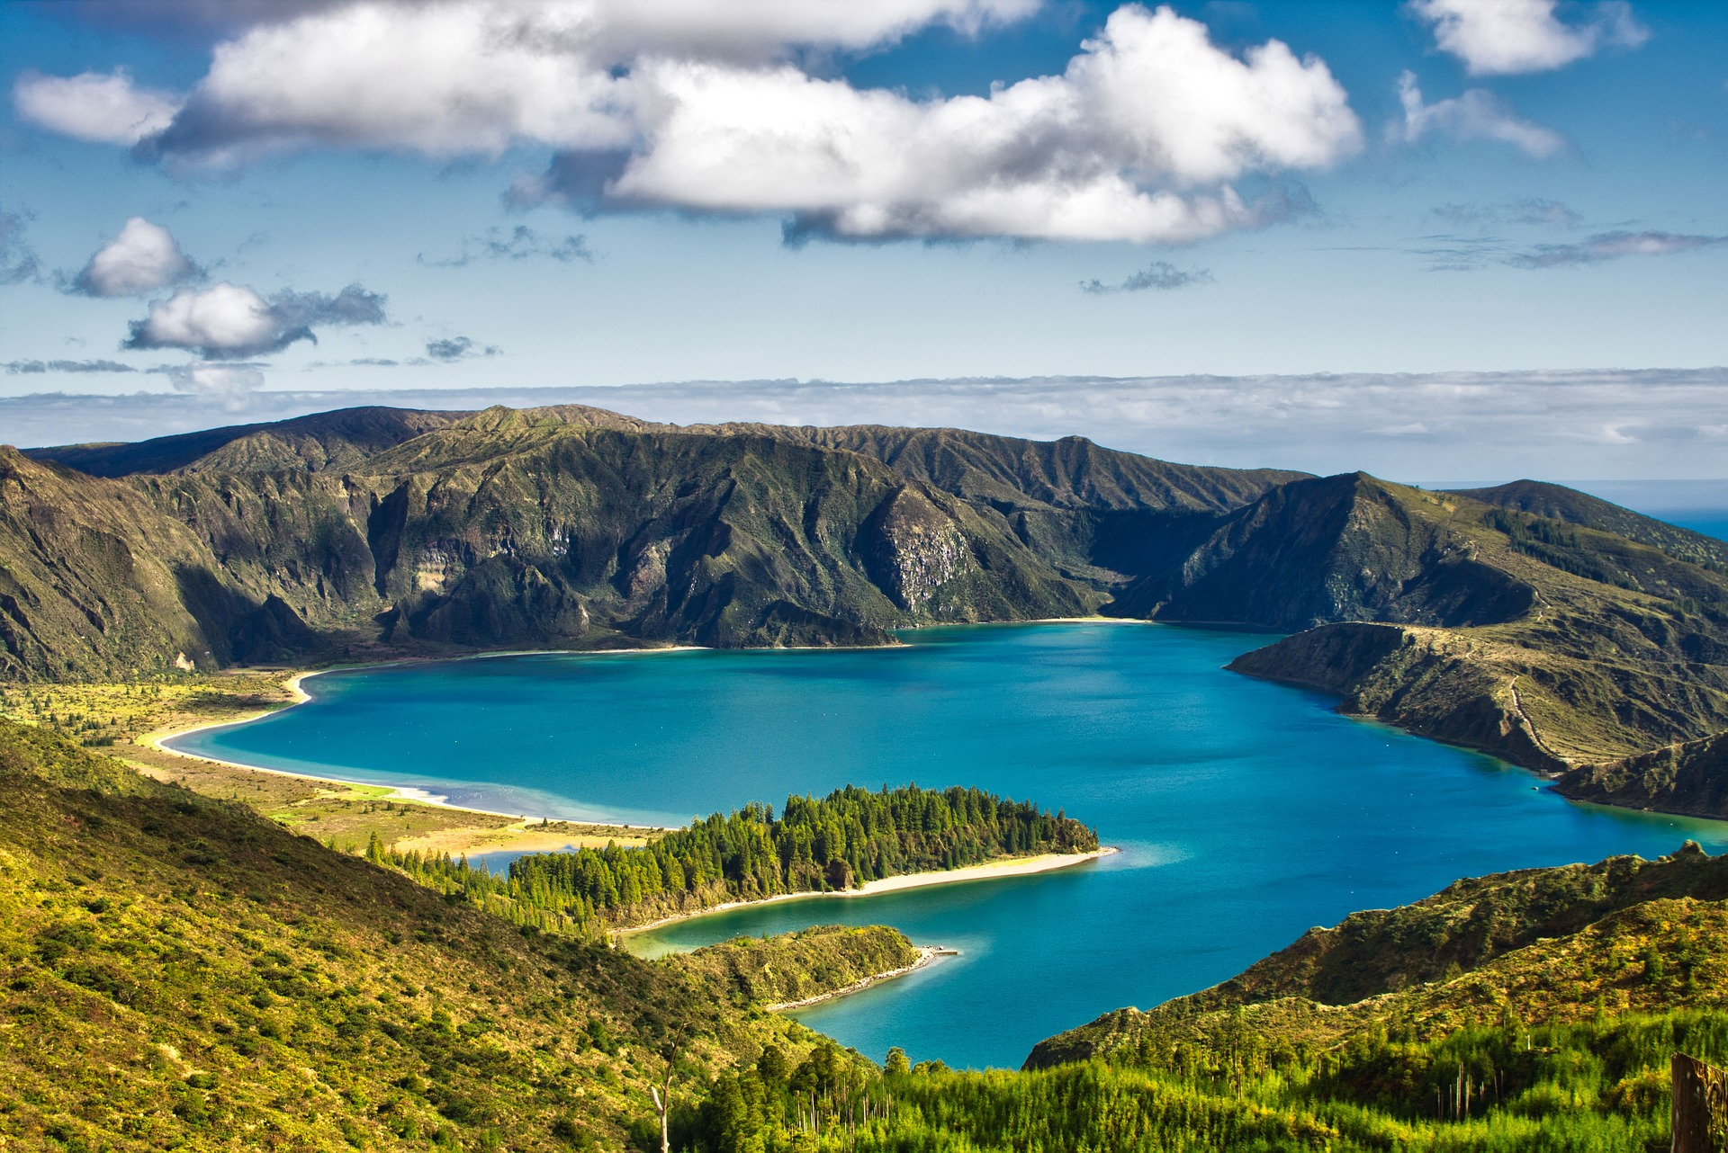
The Research Culture Island Creative Workshop
Designed by the Research Culture Team at Durham University (research.culture@durham.ac.uk)

Slide 2
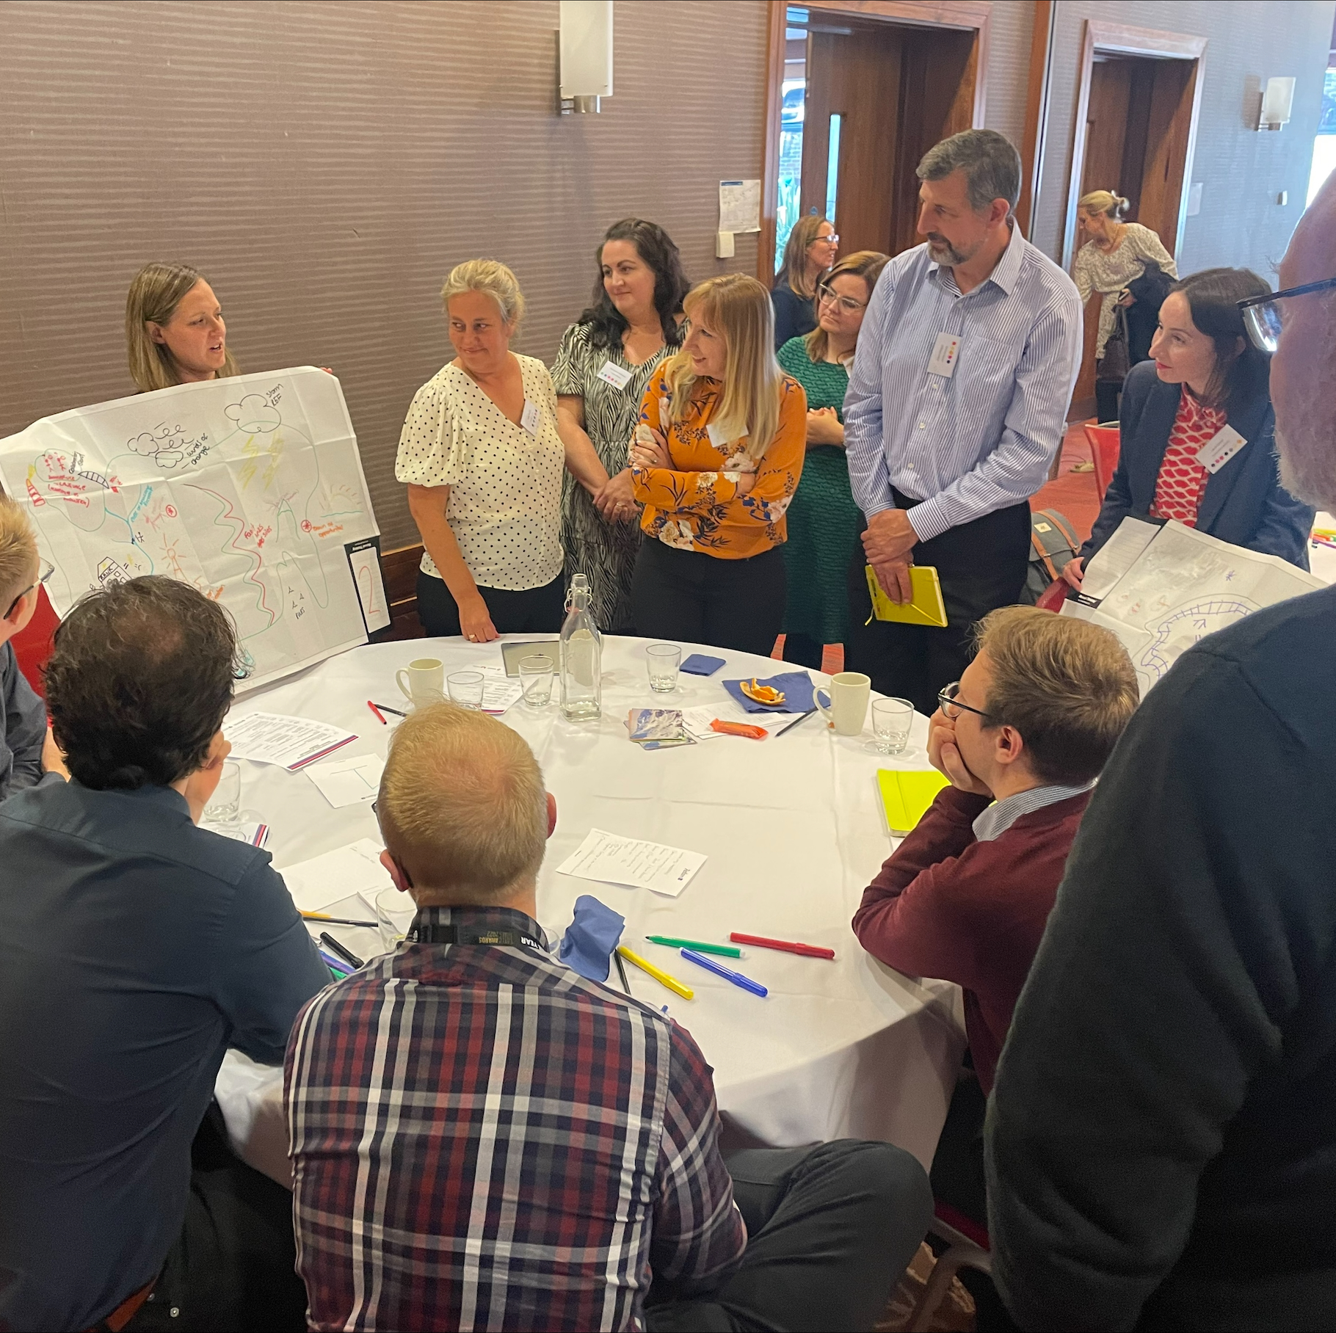
For Facilitators Resource Overview
‘Research Culture Islands’ is a creative workshop designed to explore through metaphor how we create a healthy research culture ecosystem. The aim of the session is to encourage participants to explore the research culture landscape and express some of the challenges and opportunities in a creative and safe environment.
For facilitators, the workshop offers new avenues, correlations and challenges about developing a positive research culture. The maps provide insight into commonalities across groups which might not be expressed through a Q&A discussion. These could feed into research culture strategies and project delivery and also enable further consultation on specific themes.

Slide 3
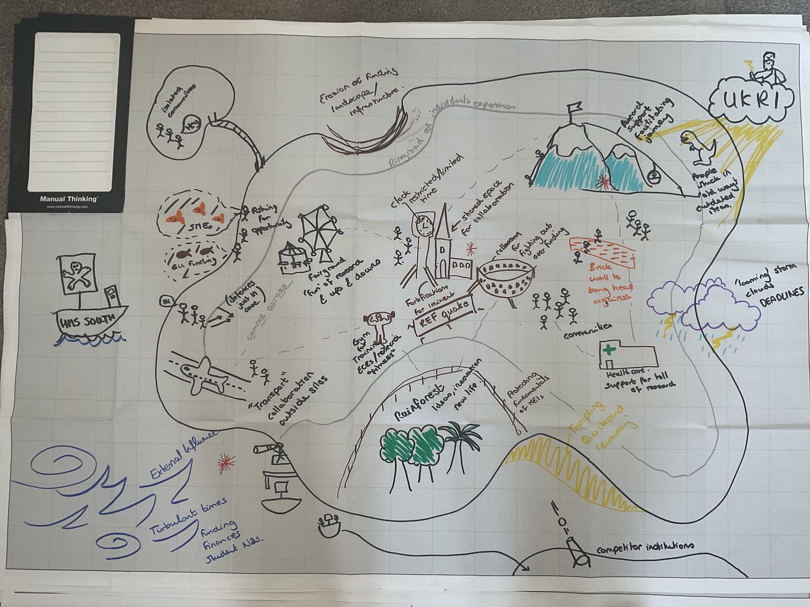
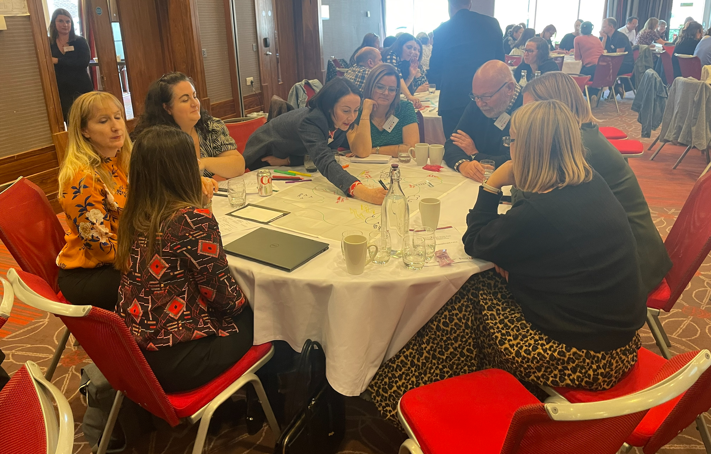
For Facilitators Resources and Materials
Materials
PowerPoint slides detailing the activity (Slides 1, 5-8)
Large Maps - Available Here: Maps Large - Manual Thinking - Tools for co-creation
Good quality colouring pens
Optional: Island stickers / other creative materials
Resource Time
Islands works well within a 1-hour timeslot
15min setup and explanation with aims
30min creative activity
15min feedback loop
The workshop requires at least one lead facilitator but works well with 2-3 facilitators to encourage discussion and to seek commonalities across the maps to highlight.
Resource Space
Islands works best in a collaborative space with roundtables with plenty of space for interaction.
It is best enabled with groups of 4 or more participants per map and works best with 20+ participants and can be upscaled effectively.
For the feedback loop, encourage 2 tables to merge for collaboration and discussion.

Slide 4
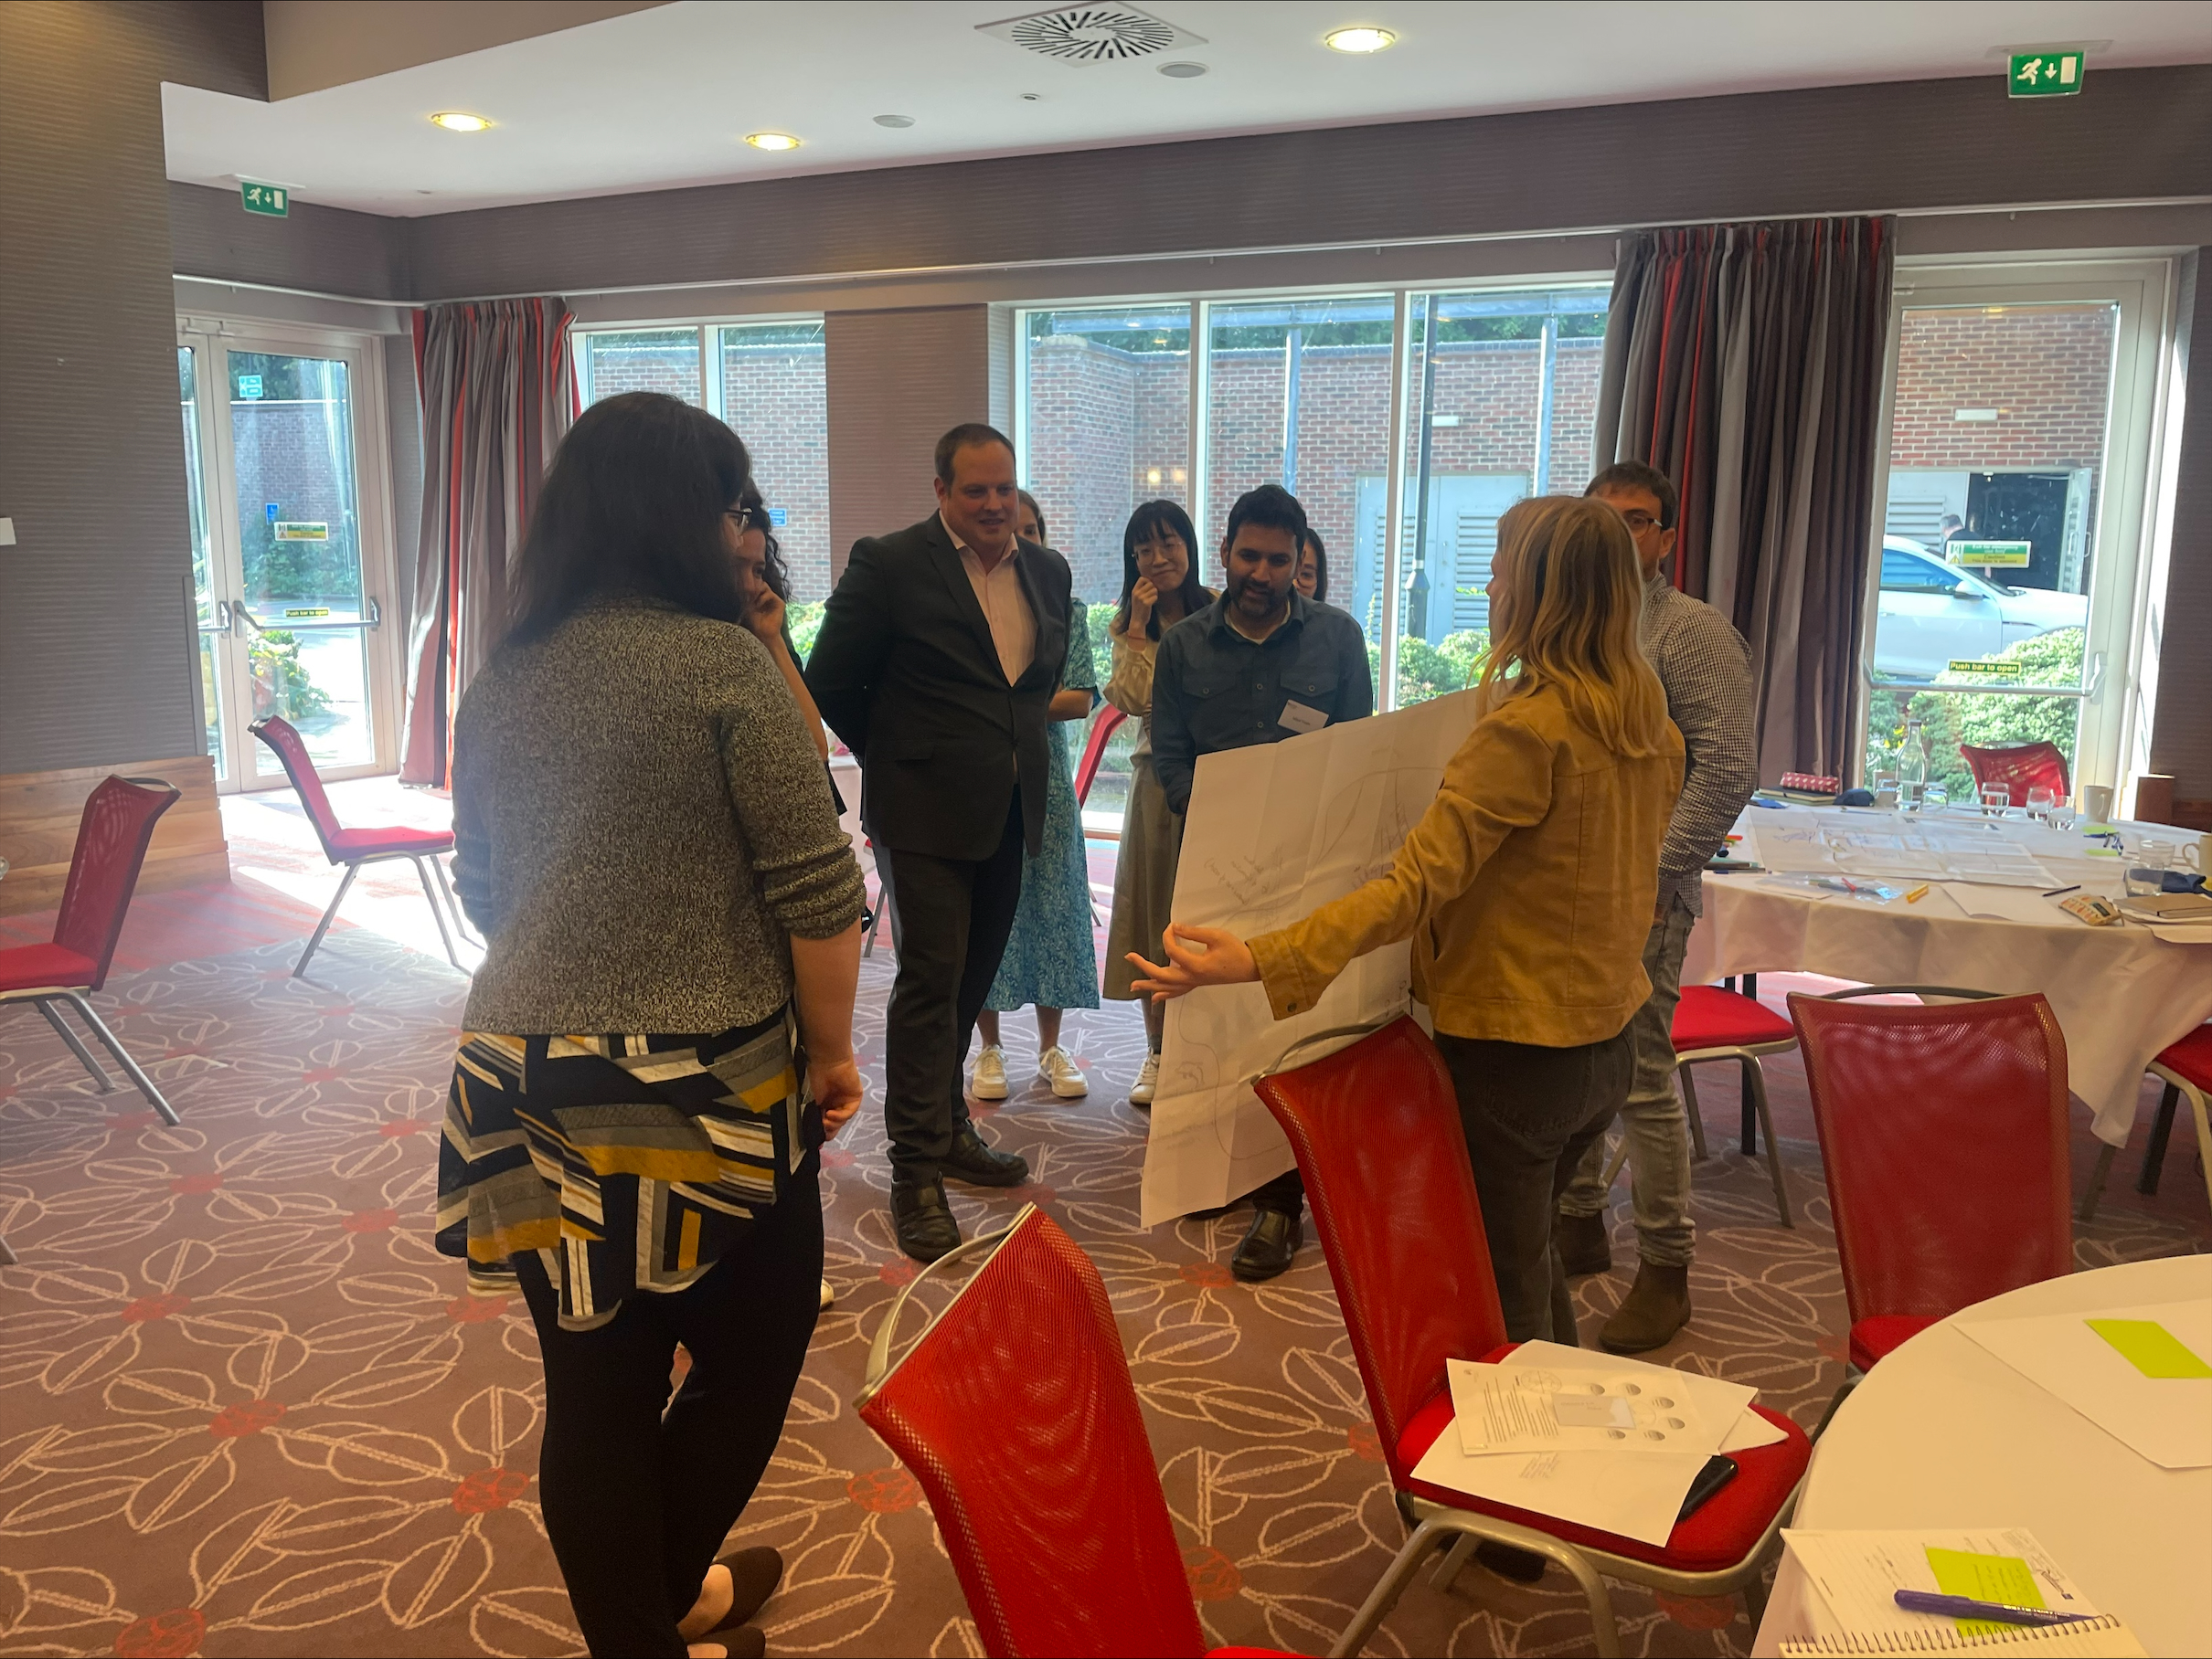
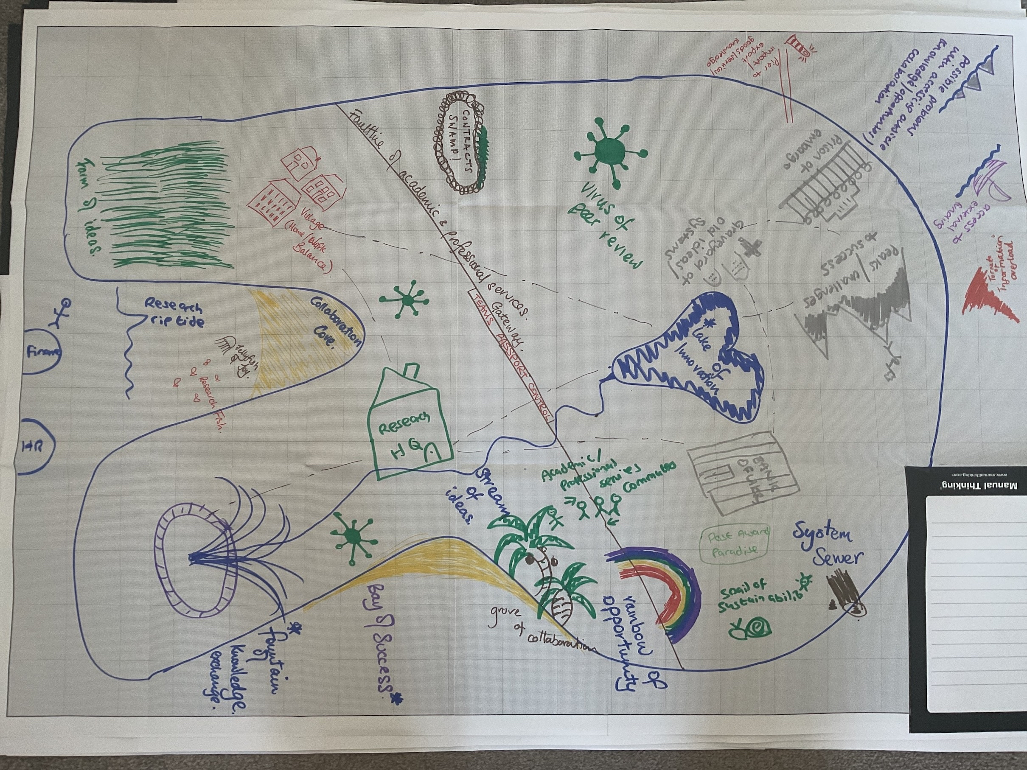
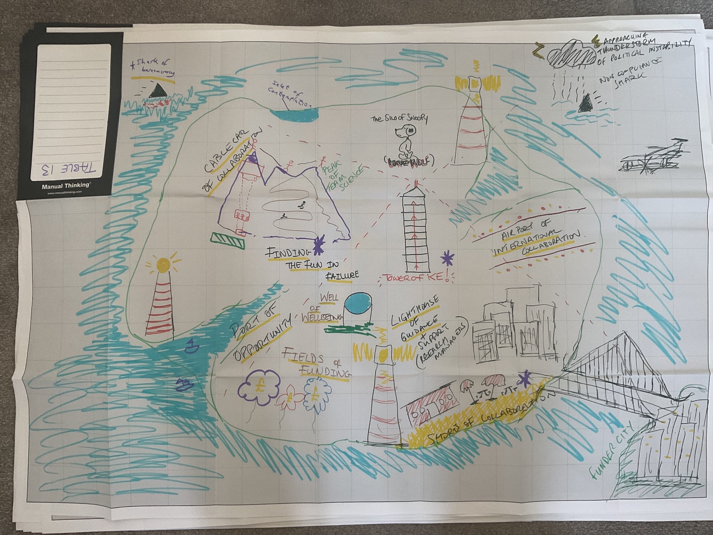
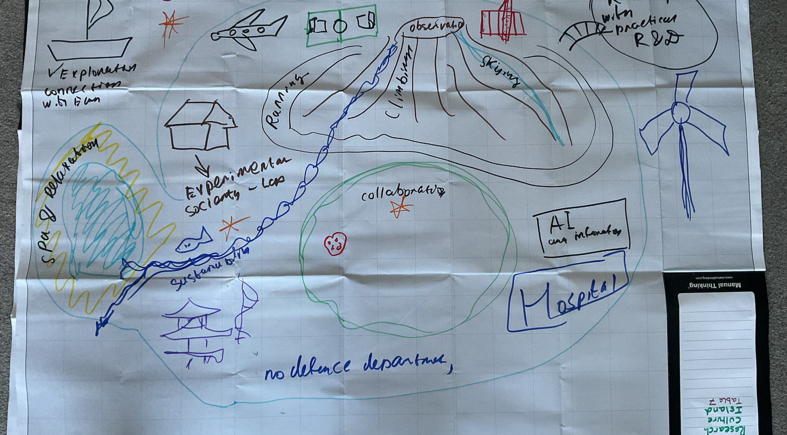
For Facilitators Outcomes
Encourages collaboration and conversation between participants
Develops networking and discussion
Encourages positive debate and dialogue
Enables positive evaluation of research culture
Communicates and explores challenges in a new way

Slide 5
Aims
To explore how a healthy research culture ecosystem and environment flourishes.
To draw and illustrate how it is constructed and sustained by creating a metaphorical island
To evaluate through geographic and poetic language the strengths and threats to the island.

Slide 6
Method
Each table has a large map and pens
In 30 minutes:
Draw an outline of an island
Then add your symbols and label the places, features and surroundings that create your research culture island.

Slide 7
Places to add and explore
Landmarks
What are the key places on the island — what makes the island flourish?
Bedrock
What is the island created from, does it have fault lines running through it?
Community
What are the most populous places and where are the opportunities for new communities?
Peaks
What is the highest point and what are the challenges to get there?
Borders
Are there challenges of getting on and off the island? Are there bridges or barriers?
Travel
How do people get around the island, are there people just helicoptering in?
Sustainability
What flowers and thrives on the island, how does it keep itself healthy?
Threats
Are there stormy waters that surround the island or whirlpools that stop people getting to there? Are there any swamps of despair?

Slide 8
Feedback Loop
Mark with an asterisk the top three aspects of your island. Then swap with the table opposite.
Consider how we might go about creating the island and what opportunities would need to be explored to build the thriving ecosystem.

