Slide 1
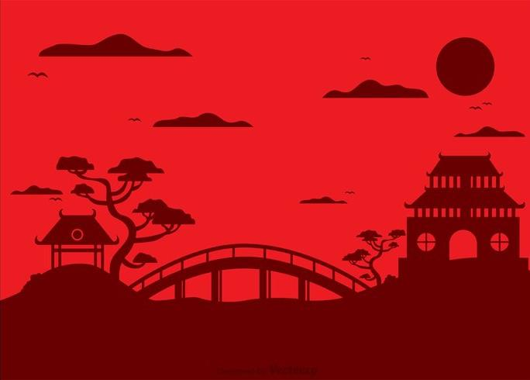
Chinese New Year Quiz
READY!

Slide 2
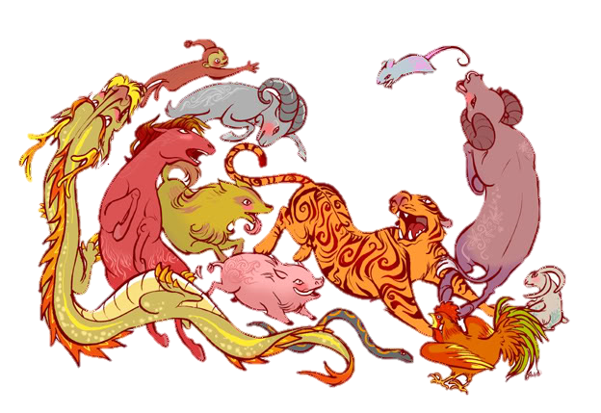
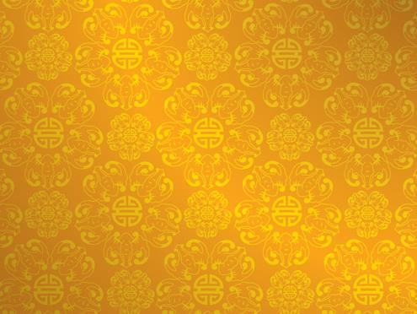
Let start with some questions about the Zodiac Story!

Slide 3
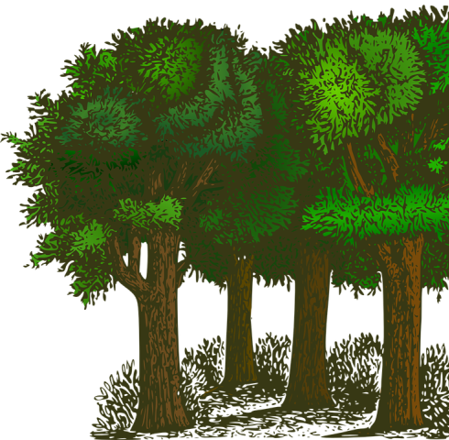
1. Where did the animals have their race?
B. The sky
C. A forest
A. A river

Slide 4
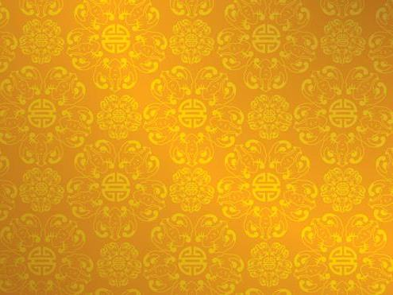
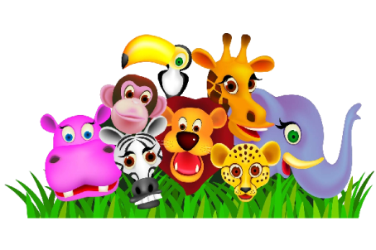
2. Why did the Emperor decide to have a race?
A. For fun
C. To name each year
B. To keep the animals healthy

Slide 5
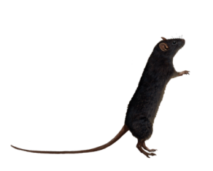
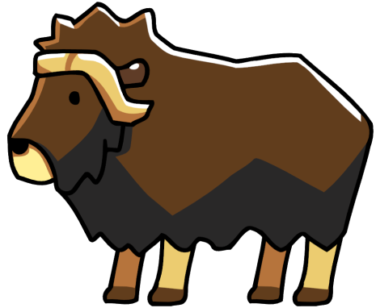
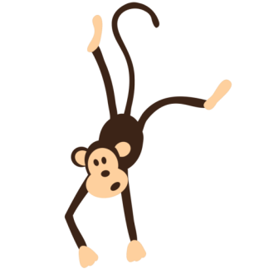
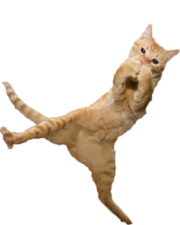
3. Who did the Rat push off the Ox’s back?
A. The Monkey
B. The Cat
C. The Frog

Slide 6
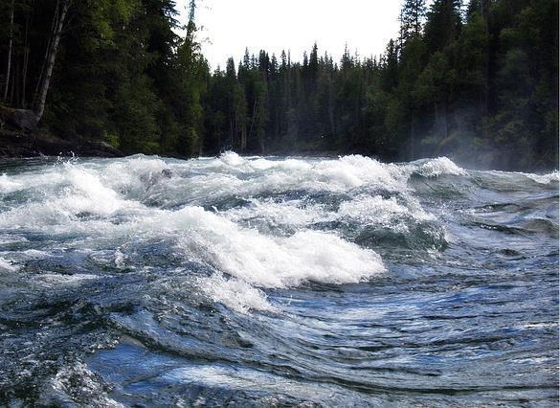
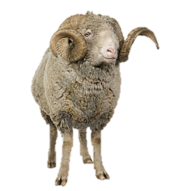
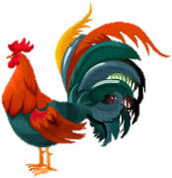
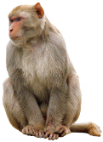
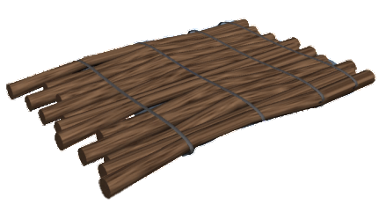
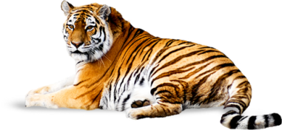
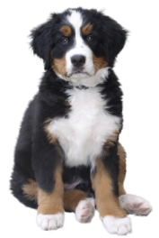
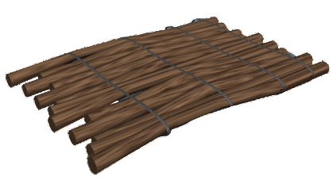
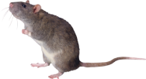
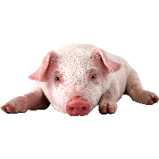
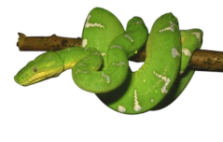
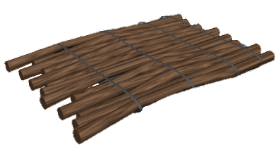
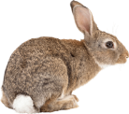
4. Which three animals made a raft together?
A. The Pig, Rabbit and Dog
B. The Rat, Tiger and Snake
C. The Ram, Monkey and Cockerel

Slide 7
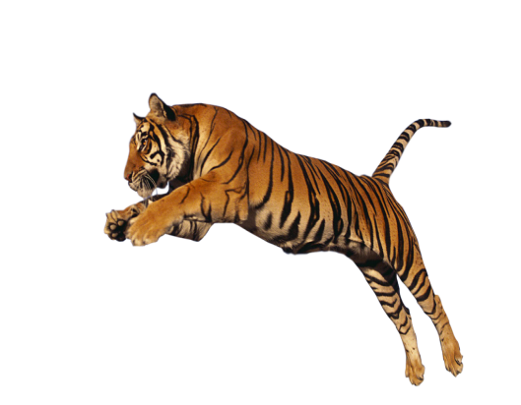
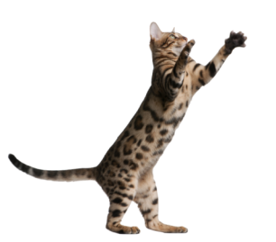
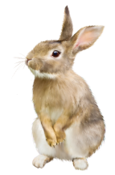
5. Which animal hopped across the river?
A. The Cat
B. The Tiger
C. The Rabbit

Slide 8
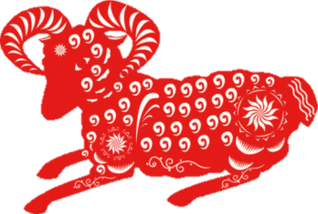
6. Which animal did not get a place in the race?
A. The Cat
C. The Rabbit
B. The Ram

Slide 9
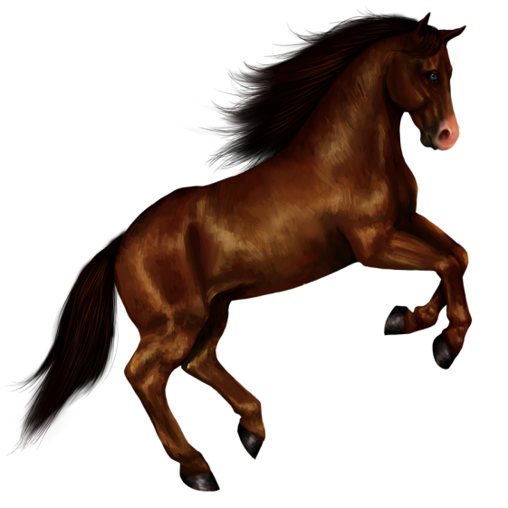
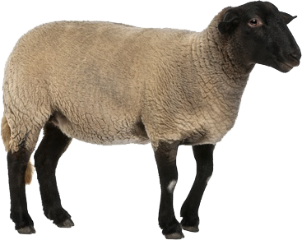
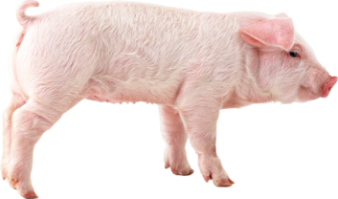
7. Which animal did the Snake wrap themselves around?
A. The Horse
B. The Ram
C. The Pig

Slide 10
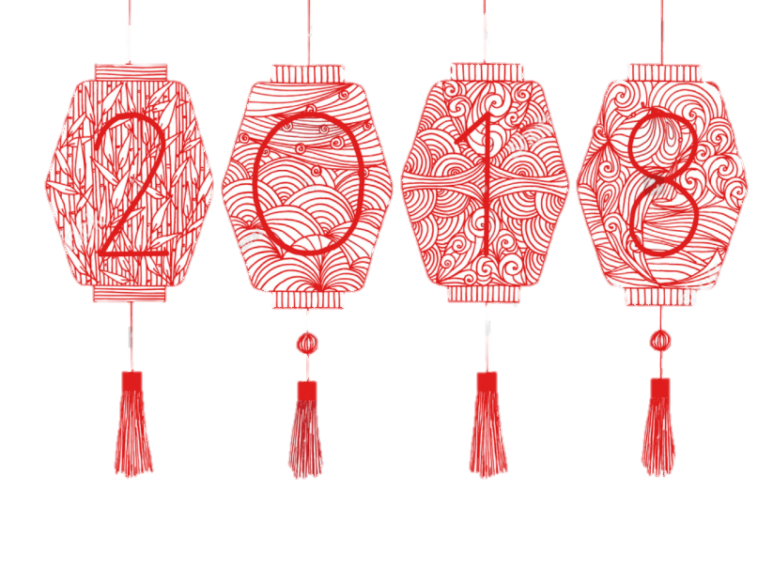
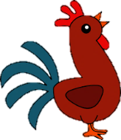
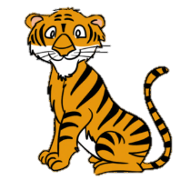
8. Which animal is the Zodiac for 2018?
A. Tiger
C. Cockerel
B. Dog
D. Dragon

Slide 11
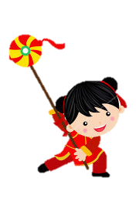
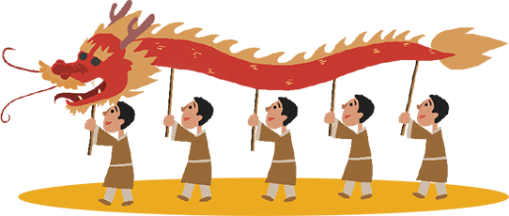
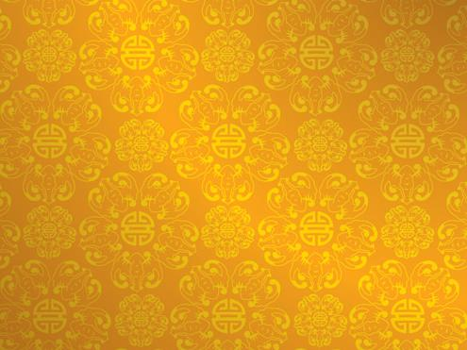
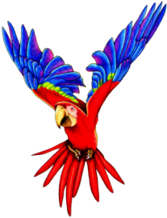
9. What does the dragon chase in the Dragon Dance?
A. A beautiful parrot
B. A tasty carrot
C. The Pearl of Wisdom

Slide 12
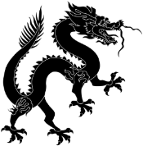
10. What was the monster called who came down from their cave once a year?
B. Simon
C. Nian
A. Kylie

Slide 13
11. What colour do houses get painted at Chinese New Year?
A. Red
B. Green
C. Blue

Slide 14
12. What do people hang up in their houses at Chinese New Year?
A. Flowers
B. Christmas stockings
C. Lanterns

Slide 15
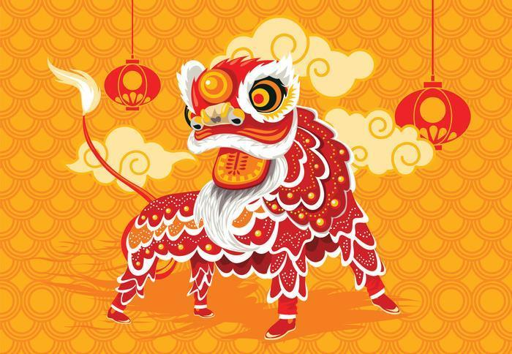
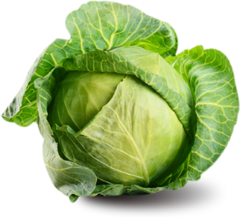
13. What can you feed a Chinese Lion for good luck?
A. Cabbage
C. Cake
B. Popcorn

Slide 16
Chinese New Year Quiz
ANSWERS!

Slide 17
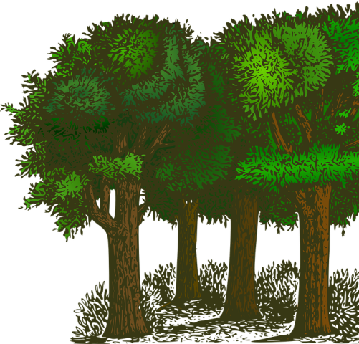
1. Where did the animals have their race?
B. The sky
C. A forest
A. A river

Slide 18
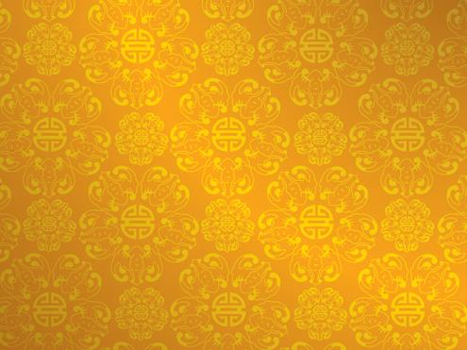
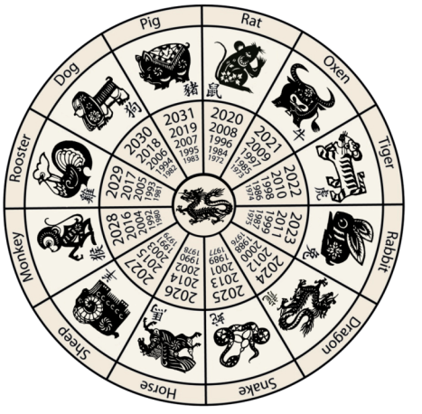
2. Why did the Emperor decide to have a race?
A. For fun
C. To name each year
B. To keep the animals healthy

Slide 19
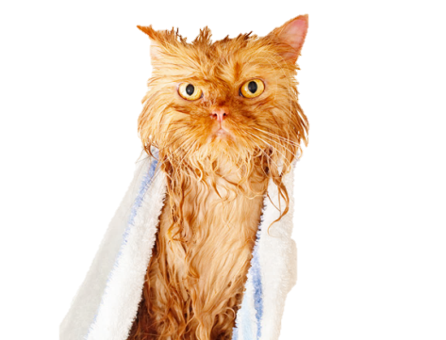
3. Who did the Rat push off the Ox’s back?
A. The Monkey
B. The Cat
C. The Frog

Slide 20
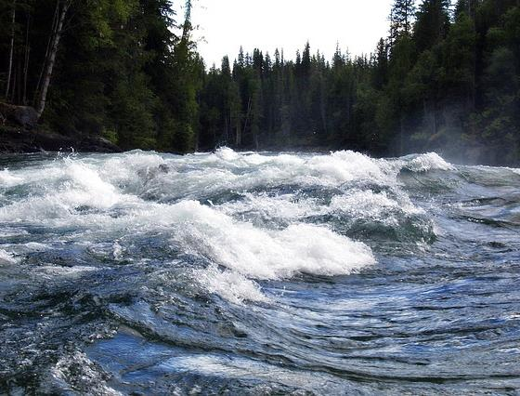
4. Which three animals made a raft together?
A. The Pig, Rabbit and Dog
B. The Rat, Tiger and Snake
C. The Ram, Monkey and Cockerel

Slide 21
5. Which animal hopped across the river?
A. The Cat
B. The Tiger
C. The Rabbit

Slide 22
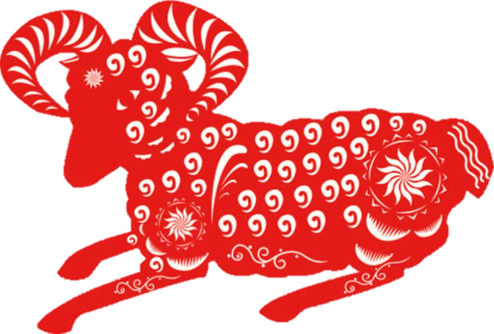
6. Which animal did not get a place in the race?
A. The Cat
C. The Rabbit
B. The Ram

Slide 23
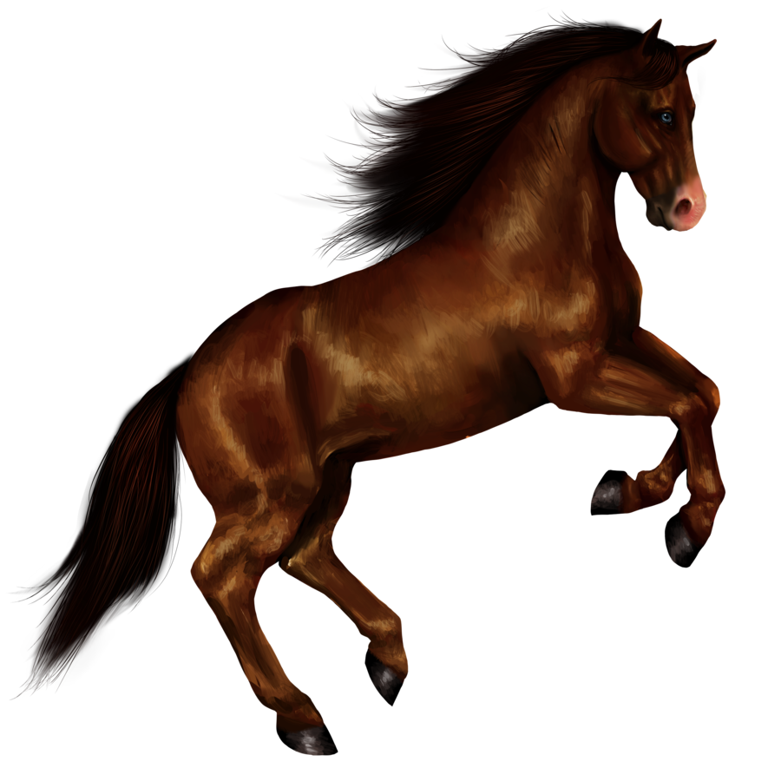
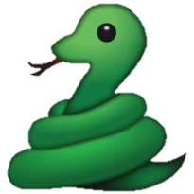
7. Which animal did the snake wrap them self around?
A. The Horse
B. The Ram
C. The Pig

Slide 24
8. Which animal is the 2018 Zodiac?
A. Tiger
C. Cockerel
B. Dog
D. Dragon

Slide 25
9. What does the dragon chase in the Dragon dance?
A. A beautiful parrot
B. A tasty carrot
C. The pearl of wisdom

Slide 26
10. What was the monster called who came down from their cave once a year?
B. Simon
C. Nian
A. Kylie

Slide 27
11. What colour do houses get painted at Chinese New Year?
A. Red
B. Green
C. Blue

Slide 28
12. What do people hang up in their houses at Chinese New Year?
A. Flowers
B. Christmas stockings
C. Lanterns

Slide 29
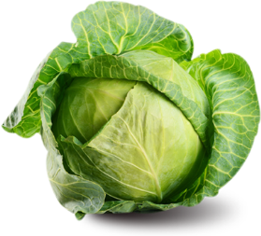
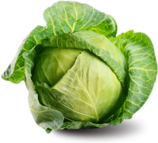
13. What can you feed a Chinese Lion for good luck?
A. Cabbage
C. Cake
B. Popcorn

Slide 30
Well done and Happy New year!

