Slide 1
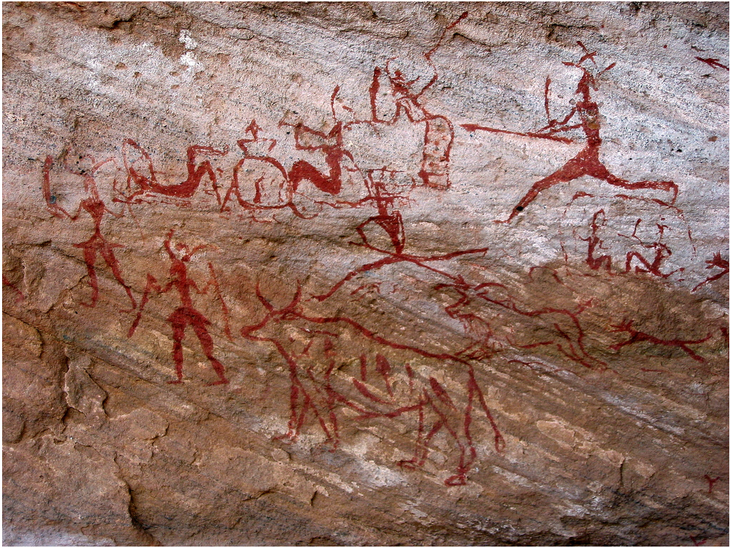
Durham University Prehistory QUIZ!
Ready!

Slide 2
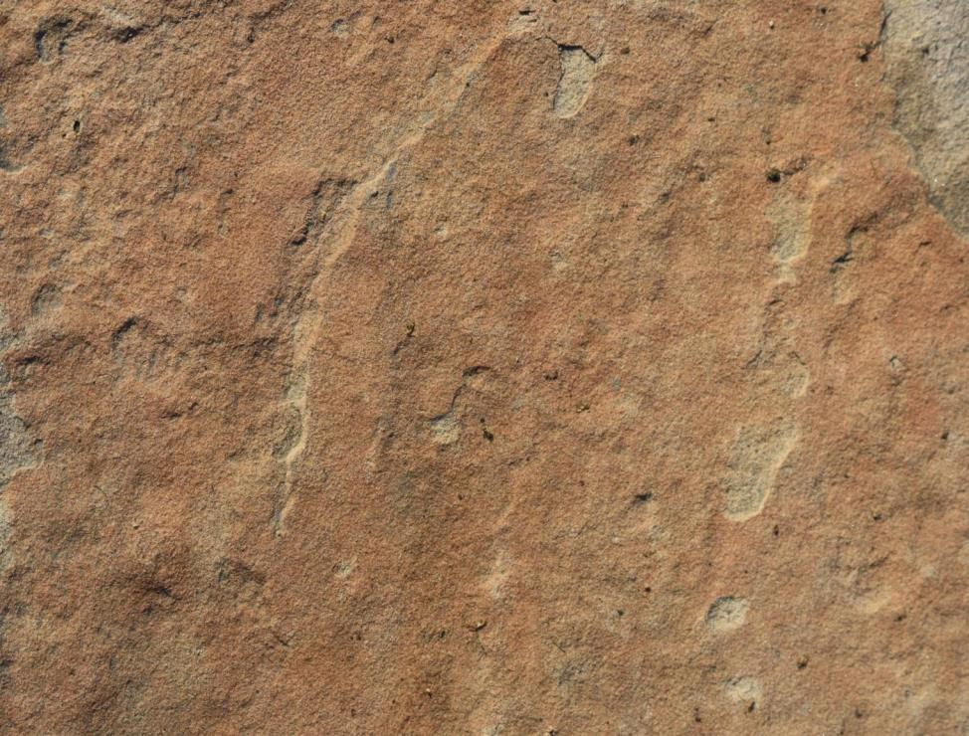
1. What does prehistory mean?
B. Before Writing
C. Before Talking
A. Before Drawing

Slide 3
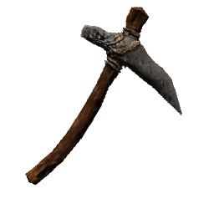
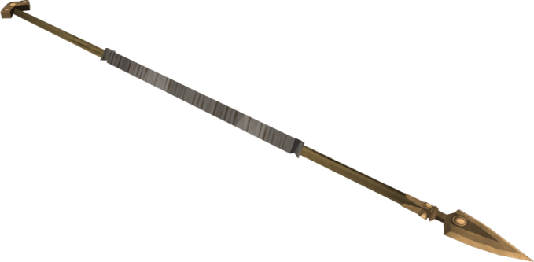
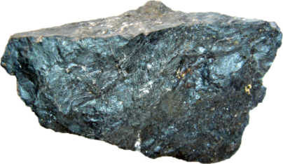
2. Put these time periods in order.
Stone AGE
Bronze AGE
Iron AGE

Slide 4
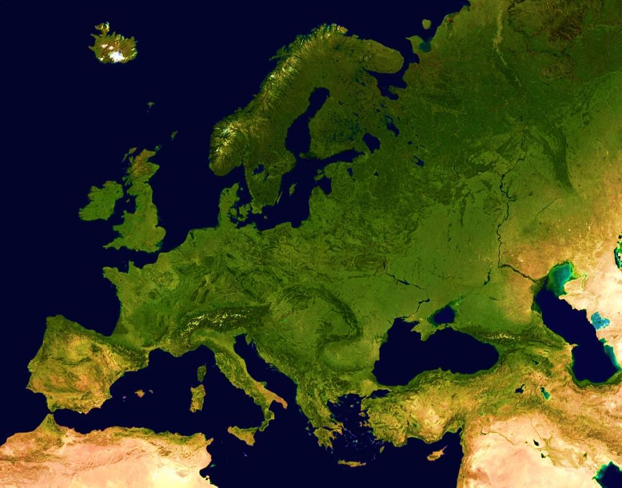
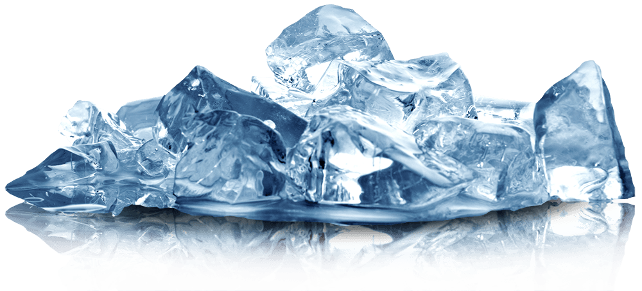
3. How did Britain become an island?
It broke off
from Europe
B. It rained and rained and rained
C. The ice melted

Slide 5
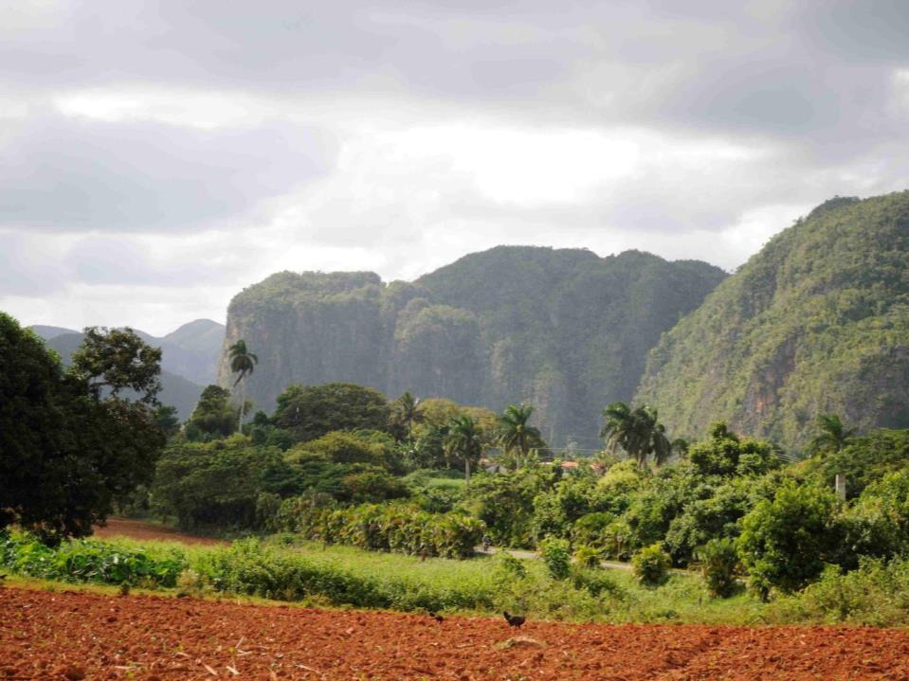
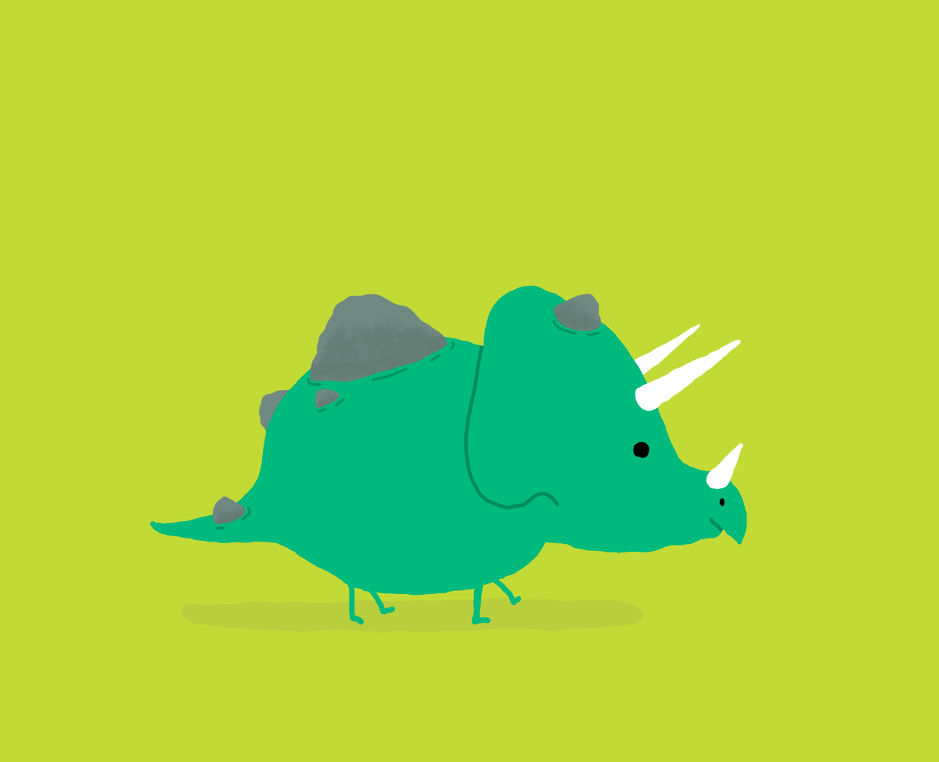
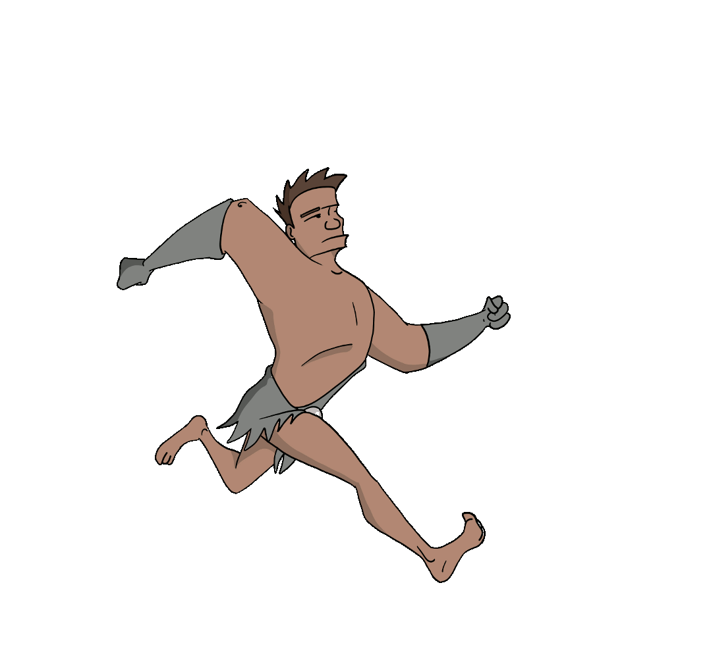
4. Did humans and dinosaurs live at the same time? Yes or No

Slide 6
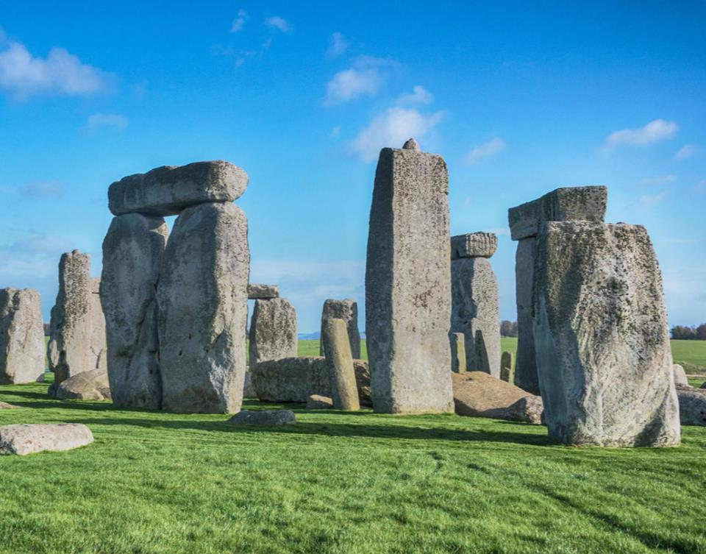
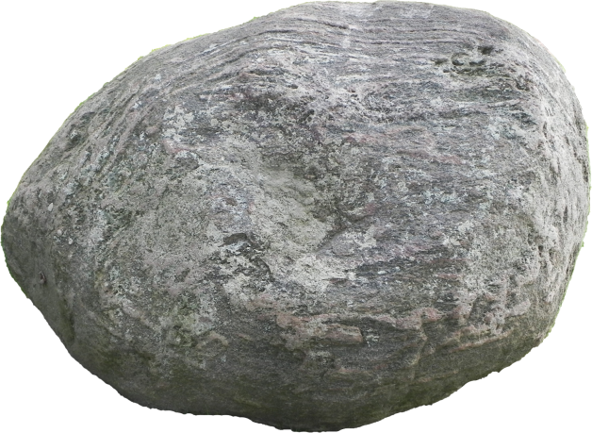
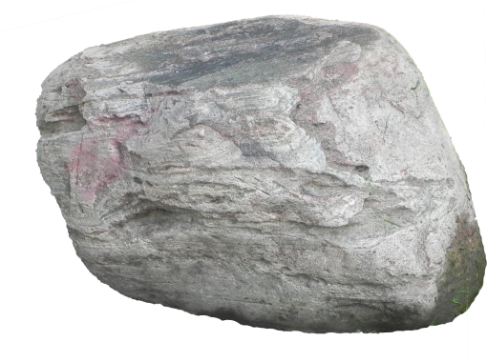
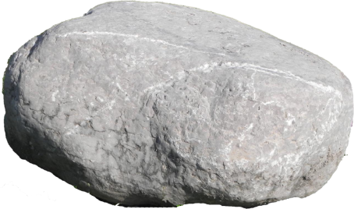
5. What does NEOLITHIC mean?
C. NO STONE!
A. New stone
B. Nice Stone

Slide 7
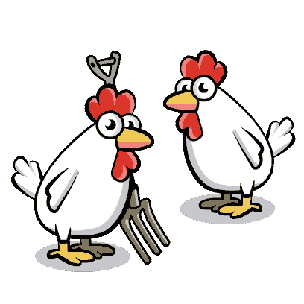
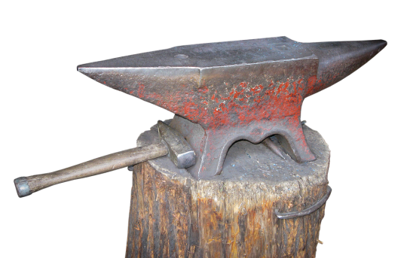
6. What did they start doing during the Neolithic Period?
B. Using the internet
A. Farming
C. Forging metal

Slide 8
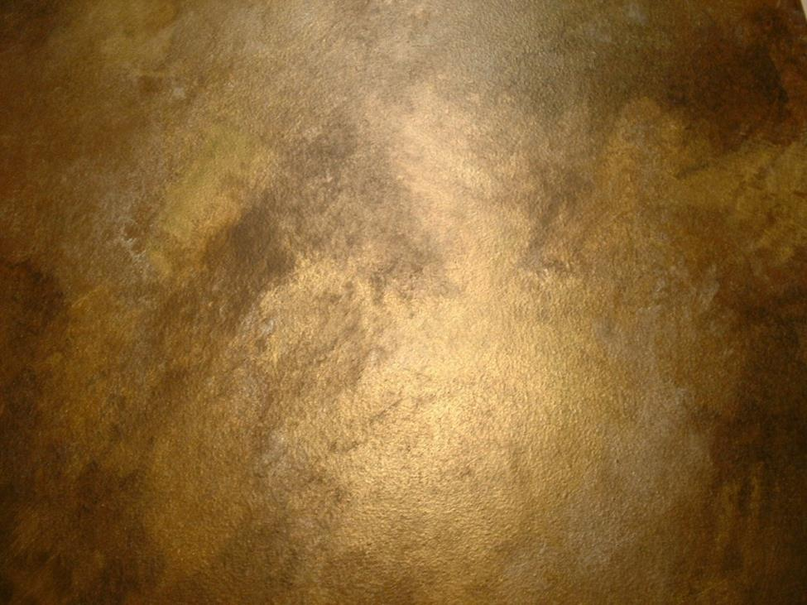
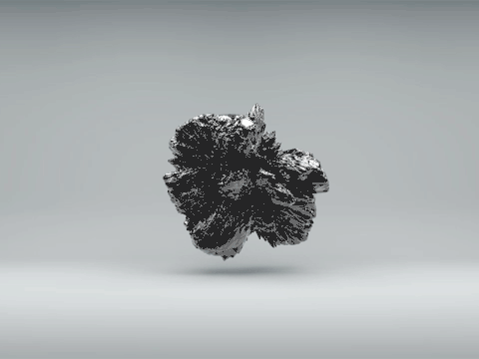
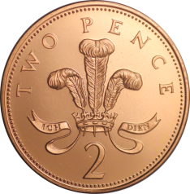
7. What is BRONZE made from? Pick two!
Gold
Mercury
Copper
Tin

Slide 9
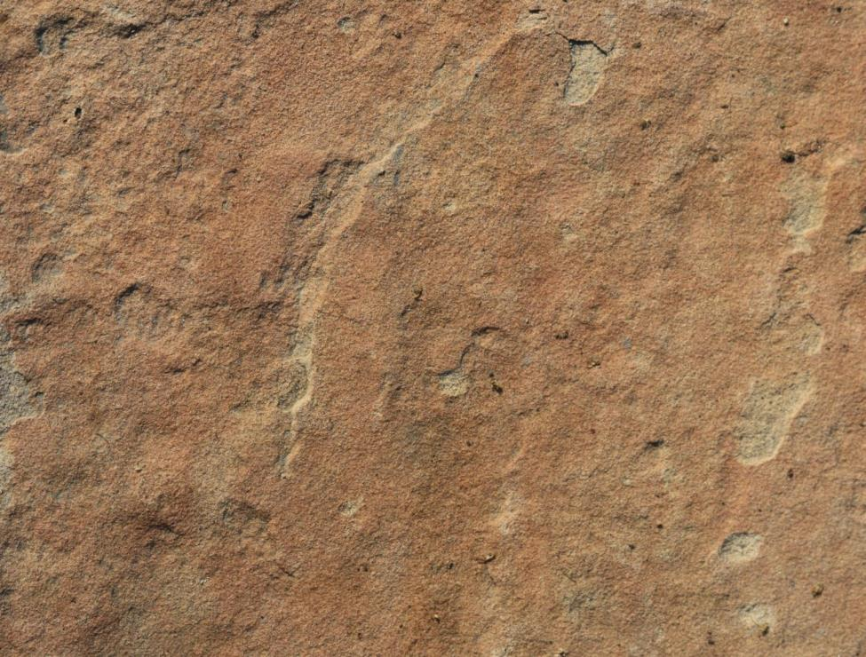
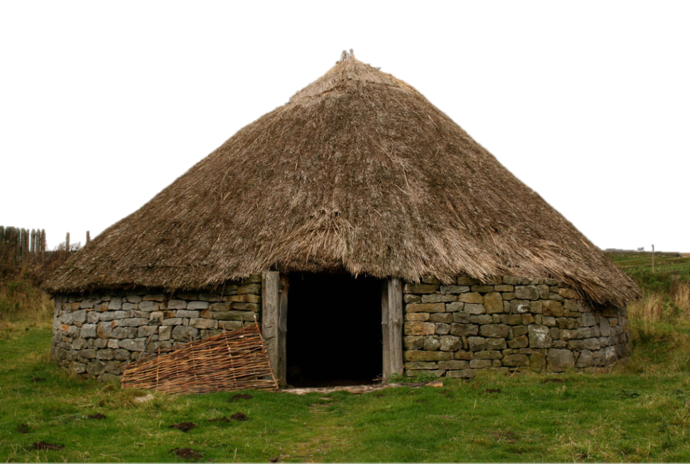
8. Name FIVE differences between your house and an Iron Age round house!

Slide 10
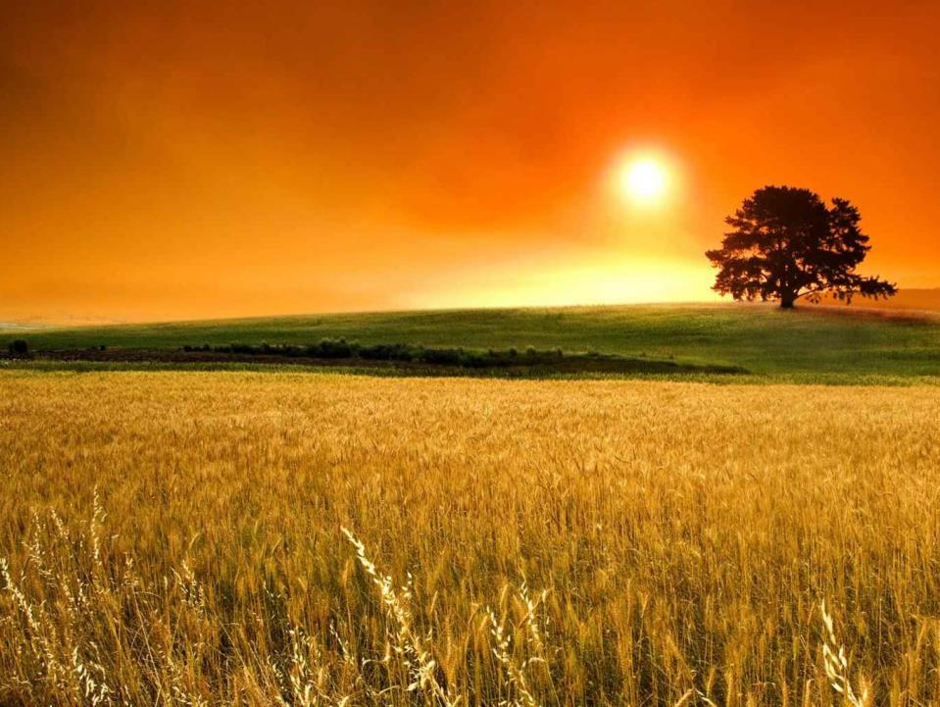
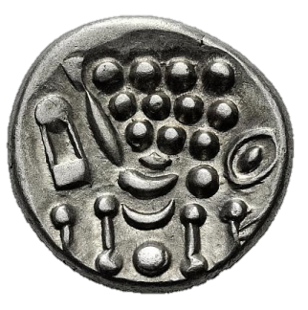
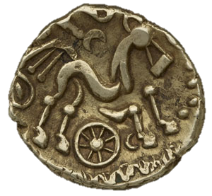
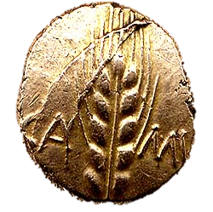
9. Which Iron Age coin would be used by a tribe who is good at farming wheat?
A
B
C

Slide 11
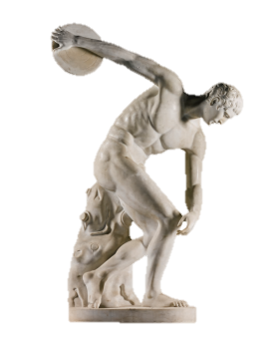
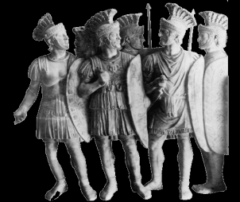
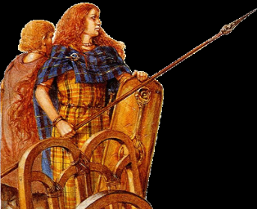
10. Who brought writing to Britain?
A. The Romans
C. The Greeks
D. Aliens
B. Iron Age people

Slide 12
Durham University Prehistory QUIZ!
ANSWERS!

Slide 13
1. What does prehistory mean?
B. Before Writing
C. Before Talking
A. Before Drawing

Slide 14
2. Put these time periods in order.
Stone AGE
Bronze AGE
Iron AGE

Slide 15
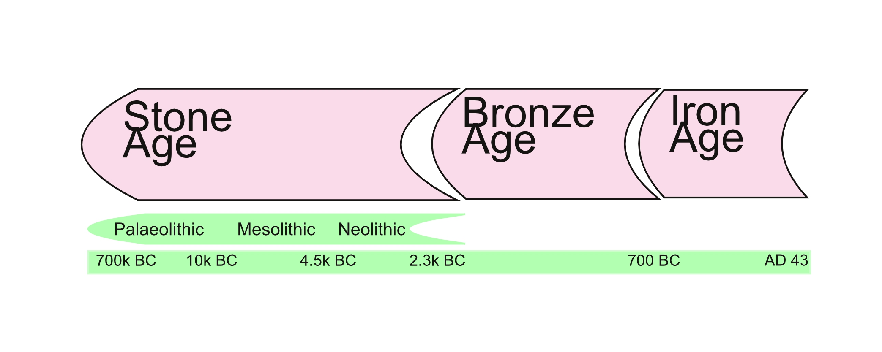

Slide 16
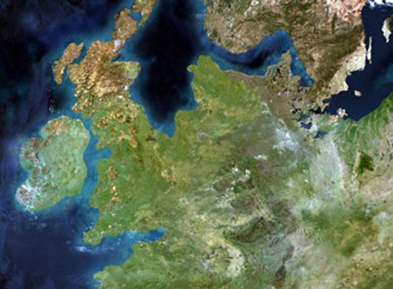
3. How did Britain become an island?
It broke off
from Europe
B. It rained and rained and rained
C. The ice melted

Slide 17
4. Did humans and dinosaurs live at the same time? Yes or No

Slide 18
5. What does NEOLITHIC mean?
C. NO STONE!
A. New stone
B. Nice Stone

Slide 19
6. What did they start doing during the Neolithic Period?
B. Using the internet
A. Farming
C. Forging metal

Slide 20
7. What is BRONZE made from? Pick two!
Gold
Mercury
Copper
Tin

Slide 21
8. Name FIVE differences between your house and an Iron Age round house!

Slide 22
9. Which Iron Age coin would be used by a tribe who is good at farming wheat?
A
B
C

Slide 23
10. Who brought writing to Britain?
A. The Romans
C. The Greeks
D. Aliens
B. Iron Age people

