Slide 1
Wear Romans Quiz!
Ready! Lets go!

Slide 2
Which year did the Romans first invade Britain?

Slide 3
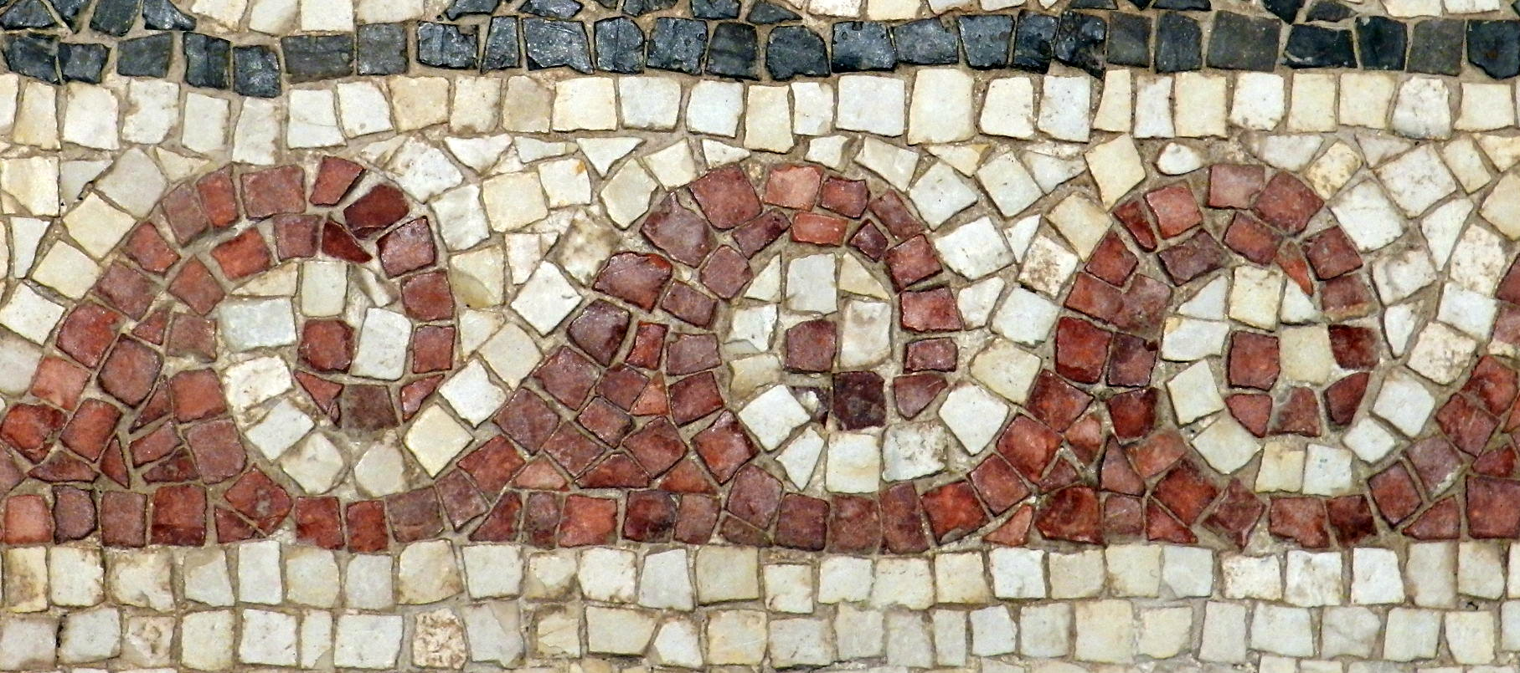
What is the correct name for a mosaic tile?

Slide 4
What did the Romans use a strigil for?

Slide 5
Match up these Latin words!
Aqua
Bonus
Canis

Slide 6
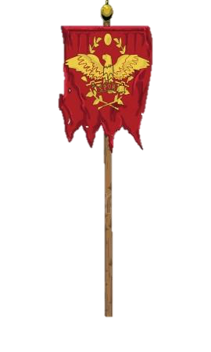
What is the name of the wall that runs through Northumberland?

