Slide 1
MSc Accounting
Durham Masters in Accounting Webinar:
Welcome to MSc Accounting Programme

Slide 2
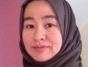
Introductions
Dr. Nor Zetty Abdul Kadir
Associate Professor in Accounting
Director of MSc Accounting

Slide 3
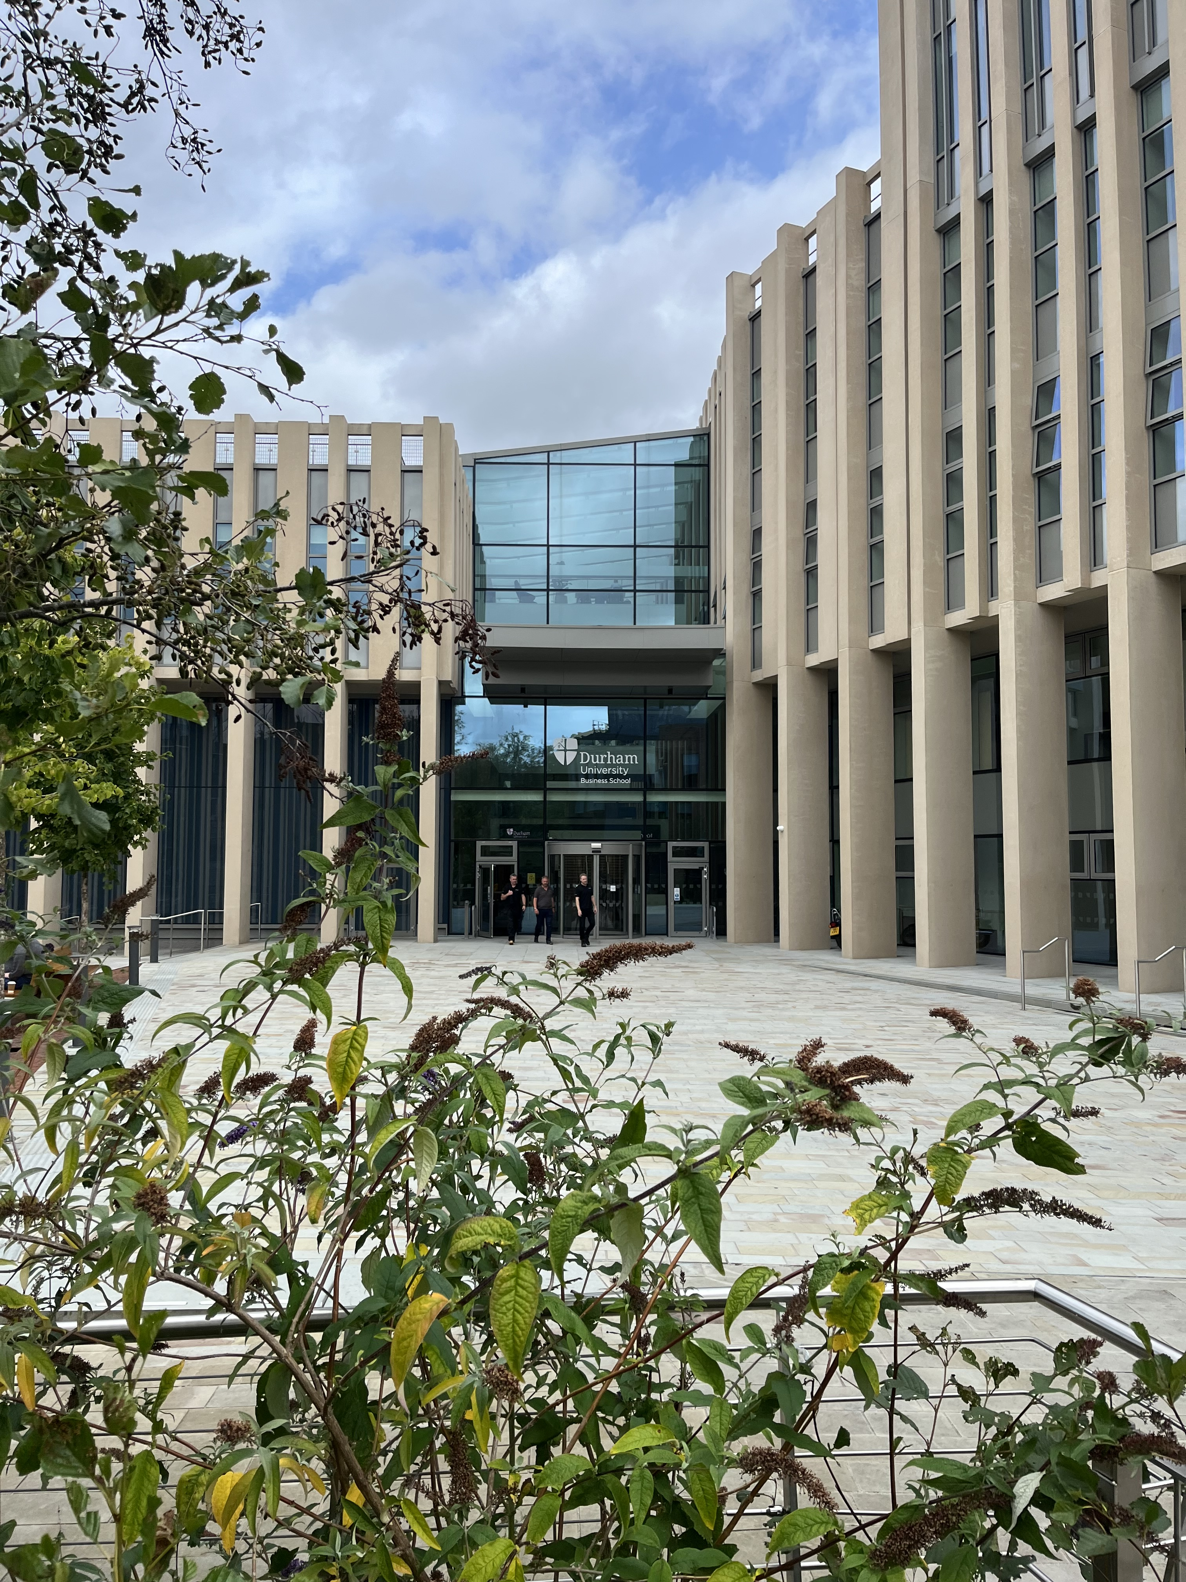
Housekeeping
So we can all get the most out of today’s session please
Mute yourself when you are not talking
Please turn your camera on during the session if you feel comfortable to do so
Please save your questions and comments for the end of the presentation OR please type any comments or questions in the chat
Raise your hand when you have something to say
Use a C in front of a comment or a Q for a question in the chat

Slide 4
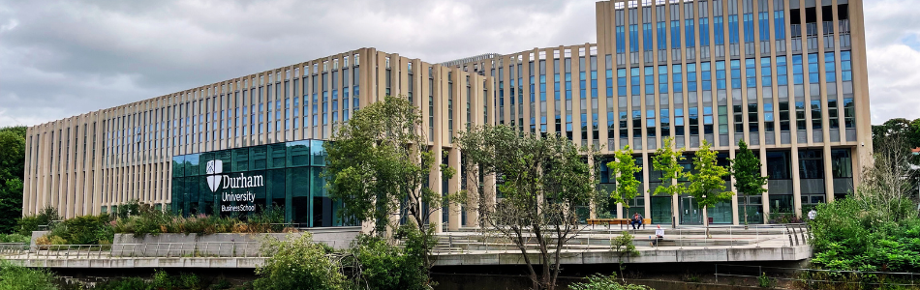
Outline of the Session
About the Department
MSc Accounting Programme & Module Overview
Masters Hub
Further Information
Frequently Asked Questions
Questions and Answers Session
Other Information & Upcoming Sessions

Slide 5

About the Department
International & UK Rankings
  76th globally
  22nd in Europe
  11th in the UK
Department culture
Student Mix: 68% Domestic, 32% International
Areas of research strength/expertise
  Academic reputation 69%
  Employer reputation 70%
76th in
the world
^{QS World University Rankings}
^{Accounting & Finance 2025}

Slide 6

MSc Accounting Programme
1-Year FT conversion-type masters in accounting
(for graduates of any discipline)
Professionally and academically qualified tutors
Accounting practice, theory and research
Professional body exemptions
  ACCA: F1,F2,F3,F4
  CIMA: 11 exemptions
  (Management Case Study& Strategic Level)
Prominent guest speakers
Students' events

Slide 7
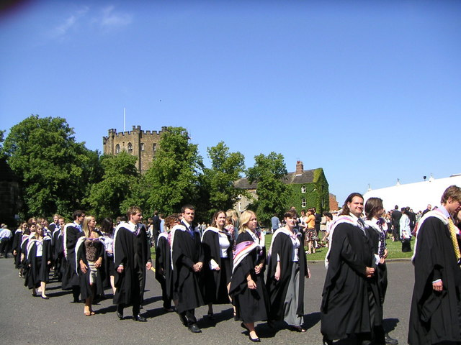
Michaelmas Term
Epiphany & Easter Terms
Summer
    Oct Dec
    Jan May
    May Sep
Core modules
*Financial Accounting & Reporting
*Financial Planning & Control
*Corporate Governance/Accounting Theory/Financial Statement Analysis
Core modules
*Auditing & Accountability
*Modern Accounting Research
*Research Methods in Accounting
    Dissertation (12,000 words)
    January
Choose options!
Pathways/ Elective module(s)
Options include modules from Islamic Finance, Data Analytics, Sustainability

Slide 8
Mode of Study
Lectures F2F and recorded on ENcore
Seminars
Formative and summative assessments

Slide 9
Module Structure
Your bit 84%
Each module handbook includes a detailed teaching and learning plan
Lectures 20 hours
Seminars 4 hours
Preparation and reading 126 Hours
Total 150 Hours

Slide 10

Masters Hub
Don't forget to check back on your Hub to help you prepare for your studies. Visit your Masters Hub
https://www.durham.ac.uk/business/programmes/masters/masters-hub/
Notes:
https://www.durham.ac.uk/business/programmes/masters/masters-hub/
https://www.durham.ac.uk/business/programmes/mba/full-time/your-durham-mba-full-time-hub/
https://www.durham.ac.uk/business/programmes/mba/online-mba/your-durham-online-mba-hub/

Slide 11
Further Information
Contact me via email: nor.a.kadir@durham.ac.uk
General admissions, enquires: https://www.durham.ac.uk/study/ask-us/
FAQ, form and telephone number
Notes:
https://www.durham.ac.uk/business/programmes/masters/masters-hub/
https://www.durham.ac.uk/business/programmes/mba/full-time/your-durham-mba-full-time-hub/
https://www.durham.ac.uk/business/programmes/mba/online-mba/your-durham-online-mba-hub/

Slide 12

Frequently Asked Questions
How many contact hours per week are there?​
How much independent work is there? Are there opportunities for groupwork?​
Are there reading lists/lists of resources I can have access before starting the programme?​
What advantage does this programme have over similar programmes at other Universities?

Slide 13

Questions and Answers
Over to you​
Please ask your questions and we will be happy to answer you​
How do you want them to ask
  Please type your questions in the chat
  Please raise your hand if you have a question

Slide 14
Other Information
Scholarships - business.scholarships@durham.ac.uk
Colleges colleges.postgrad@durham.ac.uk
International experiences business.international@durham.ac.uk
Programme team (relating changing module etc) - business.masters@durham.ac.uk

Slide 15
Upcoming sessions
Programme sessions
Durham Masters in Accounting Webinar: Taster Module -Tuesday 1 April time 10am - 11am (BST)
Durham Masters in Accounting Webinar: Q&A with your Programme Director - Tuesday 6 May 11am - 12pm (BST)
Registration via the form https://gck.fm/xzemt
Masters sessions
Masters drop in Q&A with Business School students and alumni - Thursday 17 April 2pm-3pm (BST)
Scholarships & Funding webinars- Friday 25 April 1 - 2pm (BST)
International opportunities webinars -Wednesday 28 May 12 noon - 1pm (BST)
Notes:
https://www.durham.ac.uk/business/programmes/masters/masters-hub/
https://www.durham.ac.uk/business/programmes/mba/full-time/your-durham-mba-full-time-hub/
https://www.durham.ac.uk/business/programmes/mba/online-mba/your-durham-online-mba-hub/

Slide 16
Thank You !

