Slide 1
Technology Forecasting & Innovation Analytics
Dr. Farzana Chowdhury
Notes:
Self intro

Slide 2

Outline
Module background
Assessments

Slide 3
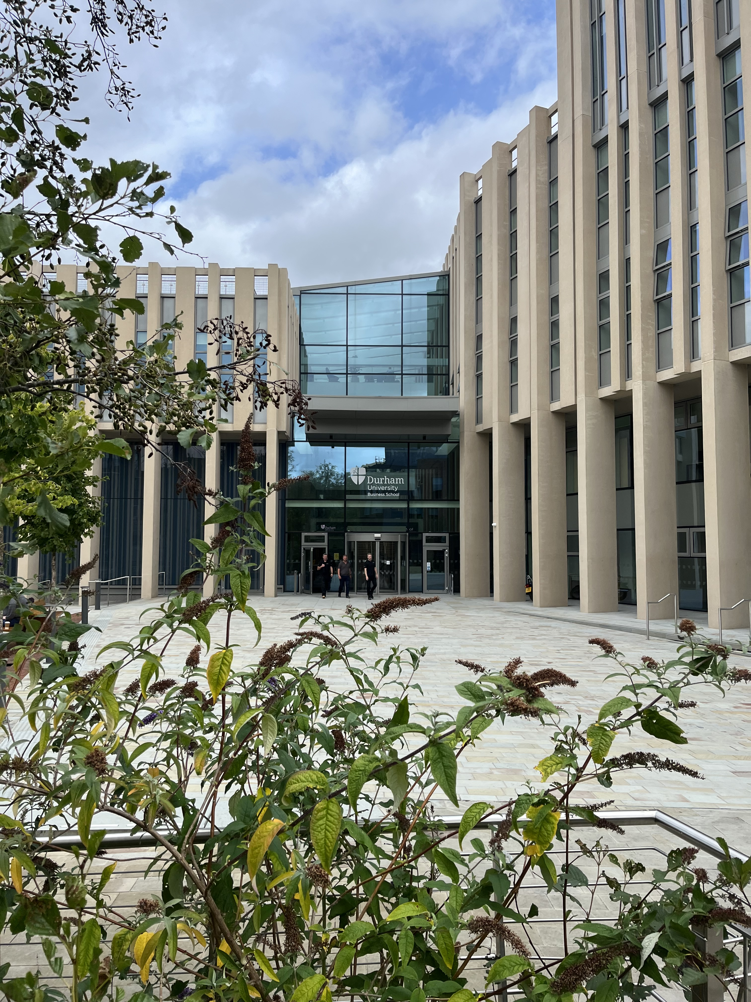
Module Purpose
External Environment
Organization
Notes:
Aims
To introduce the students to the development, drivers, and trends of Technology Innovation
To provide a critical understanding of the key theories of Technology Innovation
To identify the critical challenges for organisations that initiated or adopted Technology Innovation to create value
To explore the role of Organisational structure and culture on Technology Innovation
To compare Technology Innovation across Cultures and Geographies

Slide 4
Activities
Case studies
Discussion board
Simulation

Slide 5
Assessments
Formative
Summative

Slide 6

Questions
78th in
the world
^{Financial Times}
^{Global MBA Ranking 2024}
Email: farzana.chowdhury@durham.ac.uk

