Slide 1





BERA Hot Topic Session
2022
Assessing the Impact of the LADDER Approach to teacher development, teacher retention, and teacher wellbeing

Slide 2
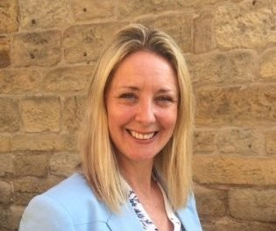





Samantha Wilkes (Leeds Trinity)
S.Wilkes@leedstrinity.ac.uk
Kulwinder Maude (Durham)
kulwinder.maude@durham.ac.uk
David Kryštof (Mendel)
david.krystof@mendelu.cz
Kulwinder Maude
Christine Callender (UCL)
c.callender@ucl.ac.uk
Leslie Blanchard (LSU)
lellb@lsu.edu
Beng Huat See (Durham)
b.h.see@durham.ac.uk

Slide 3
Project GlobeLADDER
A collaborative research partnership with Louisiana State University (US), Mendel University (CZ), Durham University (UK), University College of London (UK) and Leeds Trinity University (UK).

Slide 4

SOS
Save our staff
An increasing number of teachers frequently report experiencing mental ill-health; education professionals have the largest number of mental ill- health reports compared to any working group in Britain.
(OFSTED, 2019a)
Notes:
We are delighted to see that the front cover of the BERA Quarterly this year coincides with our focus on teacher wellbeing and mental health. Needless to say that this serves as a grim reminder that we all need to do much more than what we are doing currently to not only retain but also strengthen our teaching workforce both nationally and internationally.

Slide 5
Why teacher wellbeing matters?
Research suggests that there is a strong correlation between teachers’ wellbeing, job satisfaction and attrition (Geiger & Pivovarova 2018; Wang et al 2015)
Even before the pandemic, one in six teachers across OECD countries reported feeling very stressed in school (OECD 2021).
Attrition is highest in the first 5 years of a teacher’s career
Teacher wellbeing has a knock-on effect on students’ wellbeing and academic outcomes (Carroll et al. 2021; OECD 2019)
Notes:
The pandemic has heightened concerns about teachers’ mental wellbeing. Research suggests that there is a strong corelation between teacher wellbeing and teacher attrition. Even before the pandemic, one is six teachers reported feeling stressed. We also know that attrition is highest in the first years. Therefore, makes sense to intervene early to insulate our trainees from the challenges of teaching. If teachers are happy and satisfied with their job, they have a positive effect on students, and less likely to leave.
In the US, the impact of the pandemic on teacher wellbeing apparently led to a mass exodus of school leaders and teachers. When teachers are functioning well, they benefit not only themselves, but also their students.

Slide 6
Why are UK teachers leaving?
Only 66% of secondary teachers in England, who qualified in 2010 to 2014, stayed on in teaching in the fifth year.
(Department for Education [DfE] 2018, 2019; NFER, 2021)
Common reasons reported for the early departure of teachers are:
Workload
Lack of adequate support from school administration
Poor preparation for dealing with the stress and workload associated with teaching.
According to the Schools and Staffing Survey (SASS) and the (TFS), over three decades from 1987-2018 (Ingersoll, et al) and Education Week, January 2018:
Notes:
So, why are teachers in the UK leaving?

Slide 7
What about Czech republic?
60 percent of teacher education graduates do not become teachers (Hanusova 2017).
It is estimated that approximately 35% of educators leave the profession in the first few years.
In the Czech Republic:
Main reasons for leaving the teaching profession:
relationships with pupils and classroom activities,
relationships with colleagues and relationships with school management.
Notes:
In the absence of targeted data collection, this 35% drop-out rate of teachers in their first few years is a qualified guess by the Ministry of education (confirmed with David)

Slide 8
Why are US teachers leaving?
Why are teachers leaving?
44.4% Cite “Dissatisfaction”
62% Cite “School Culture and Working Conditions”
Lack (or perceived lack) of Administrative Support
Lack of input or voice into educational decision making
Lack of Developmental Opportunities
ASCD refers to School Culture as “the way teachers and other staff members work together and the set of beliefs, values and assumptions they share”.
*Only 17% cited salary as a reason for quitting
“Stress” is the primary reason cited for teacher leavers in both pre-pandemic and post-pandemic research (Diliberti et al, 2021).
According to the Schools and Staffing Survey (SASS) and the Teacher Followup Survey (TFS), over three decades from 1987-2018 (Ingersoll, et al) and Education Week, January 2018:

Slide 9
How does LADDER address the teaching shortage and retention issue differently?
LADDER addresses the root cause of teacher stress and burnout
It uses principles of reflective practice and cognitive-behavioural approach
It helps teachers to identify those dispositions that are likely to cause stress
Builds resilience
Equips teachers with coping strategies to deal with the demands of teaching
Prepares pre-service teachers for transition to teaching in school
Supports in-service teachers by enhancing their self-efficacy and job satisfaction
Notes:
Scientific or Scholarly Significance
1) An evidence based validated instrument for disposition screening and development
2) A replicable model for teacher preparation programs to develop dispositions in aspiring educators
3) A diagnostic and prescriptive tool for in-service educators to identify stressors through self reflection
4) Framework for current and perspective administrators to develop relevant leadership dispositions

Slide 10


Research Process and Publications
Leadership Development Institute
Developing Leaders for Social Impact

Slide 11

Leadership- the capacity to get others to willingly follow
Alphabet- A set of 26 unique symbols that form words when combined
Dispositions- The habits of mind and moral commitments that underlie an educator’s performance
Development- enhancement based on assessment and coaching
Engagement- the mental and emotional connection employees feel toward their work, their team, and their organization
Reflection- learning through and from experience toward gaining new insights of self and practice
VOCABULARY

Slide 12
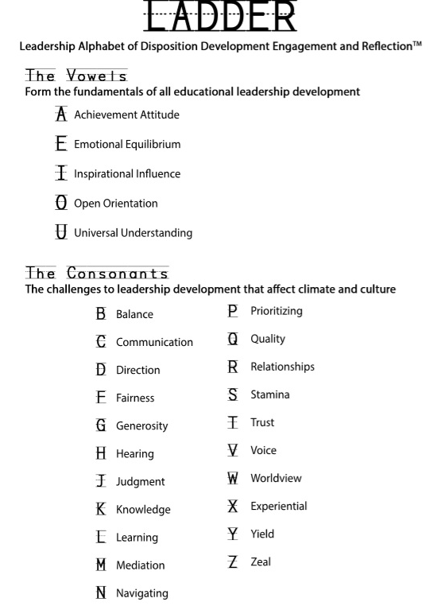



Material Results
Notes:
Material Results

Slide 13

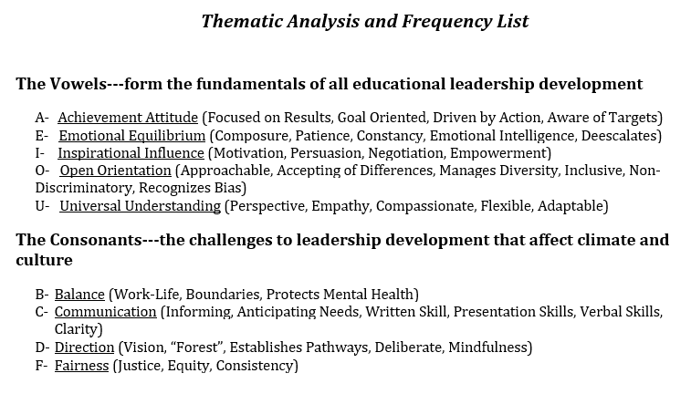
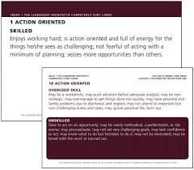
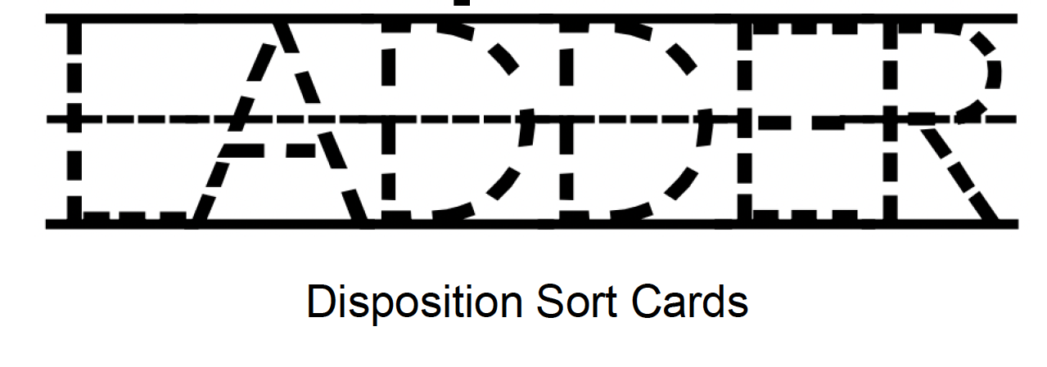


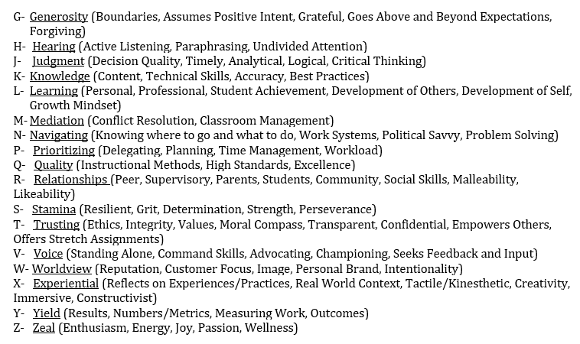
The Evolution of
LADDER
Methods
“What are the most important competencies in educational leadership?”
(2009-2020)
“What is missing from the framework?”
Expert Revision
Qualitative
Keyword Thematic
Analysis
n=242
Test-Retest Reliability
n=104, r=0.93
Quantitative
Lawshe’s Content Validity Ratio
n=512
Content/Construct Validity
Item Analysis Agreement= 99.3%
Notes:
Methods

Slide 14
Card Sort and Data Collection
Leadership Development Institute

Slide 15
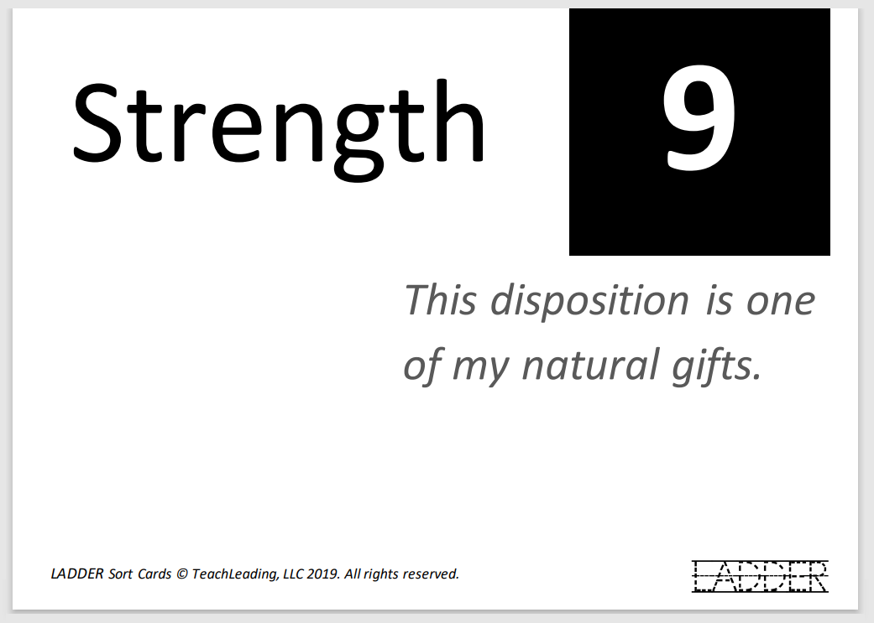
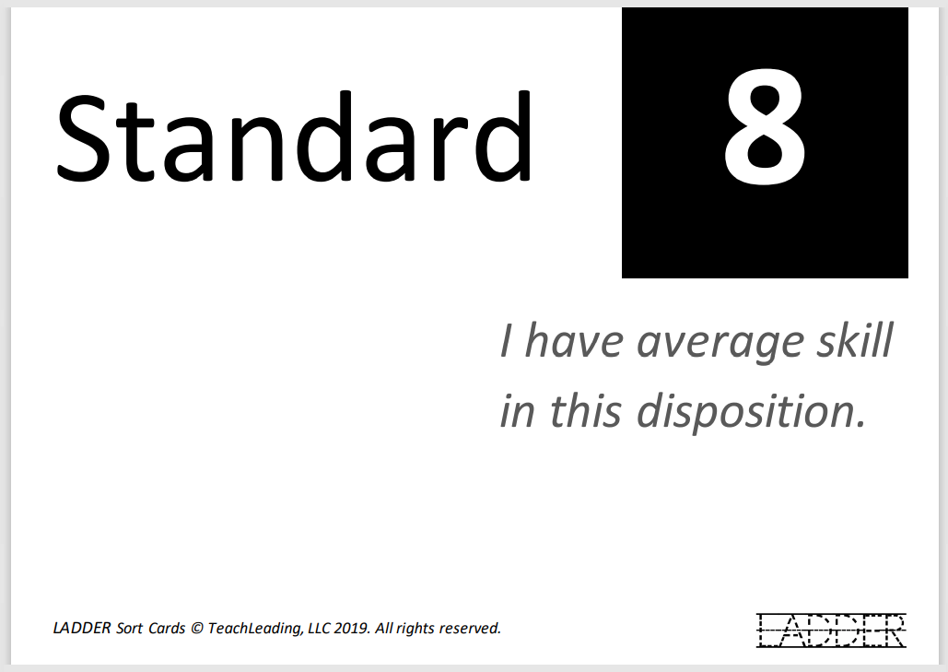
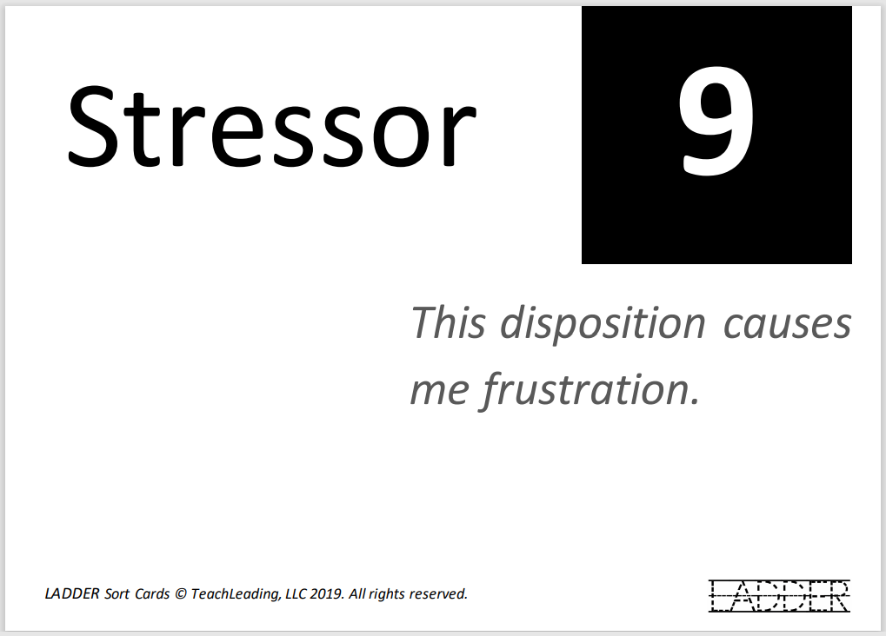
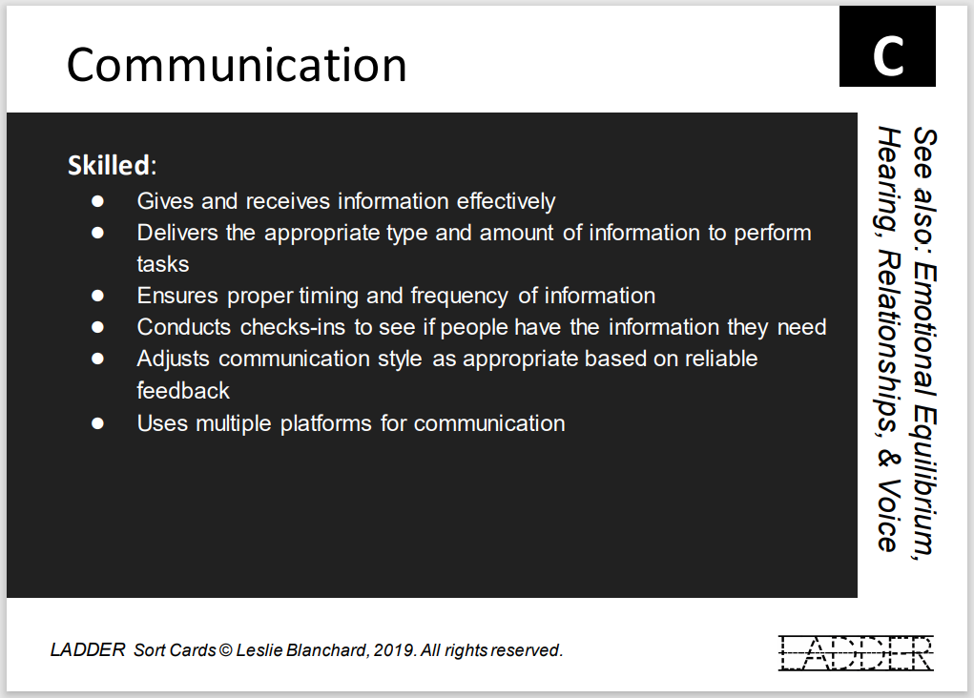
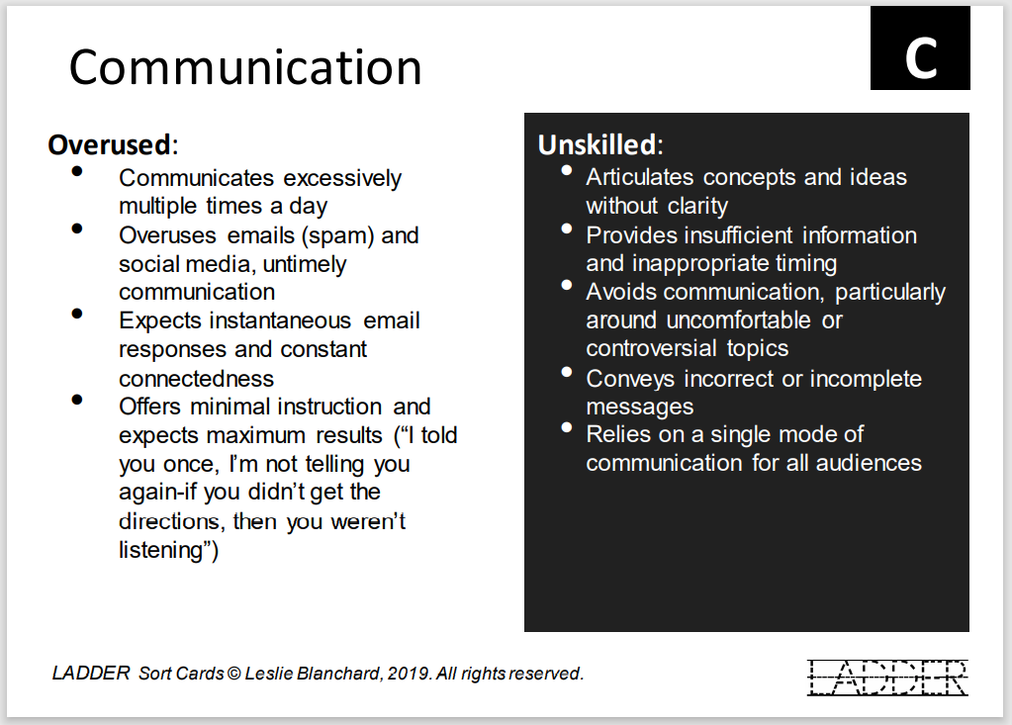
Assessment Process
Front of Card:
Behavioral statements describing what it looks like when done well.
Back of Card:
Behavioral statements describing what it looks like when development is needed.

Slide 16
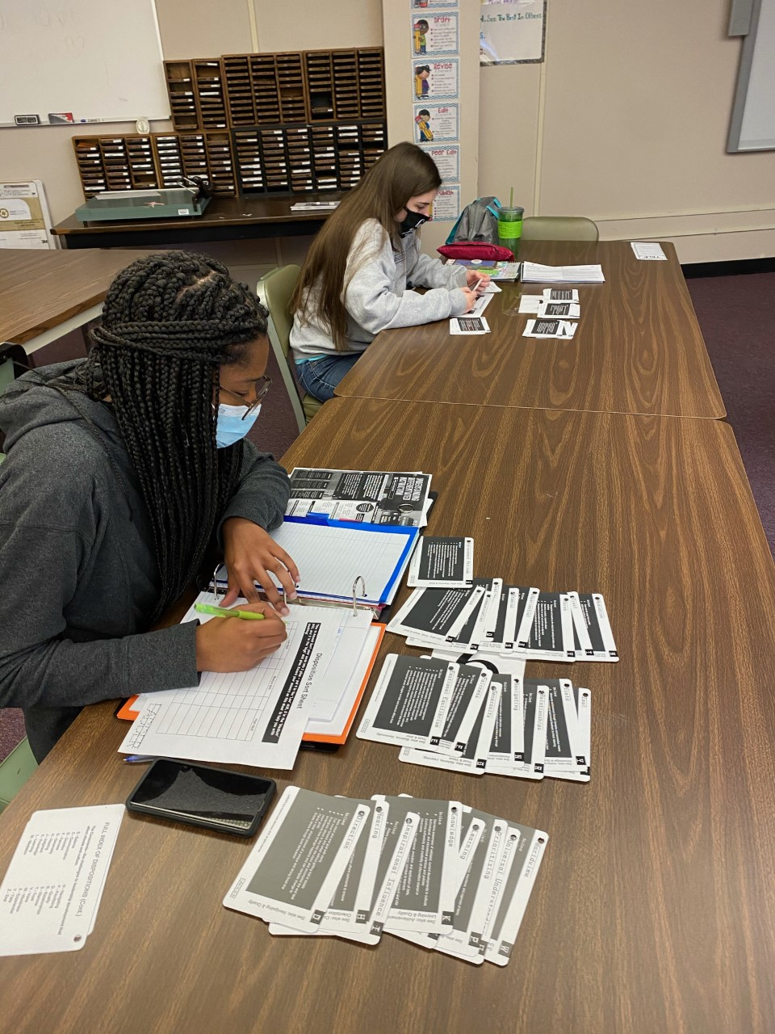
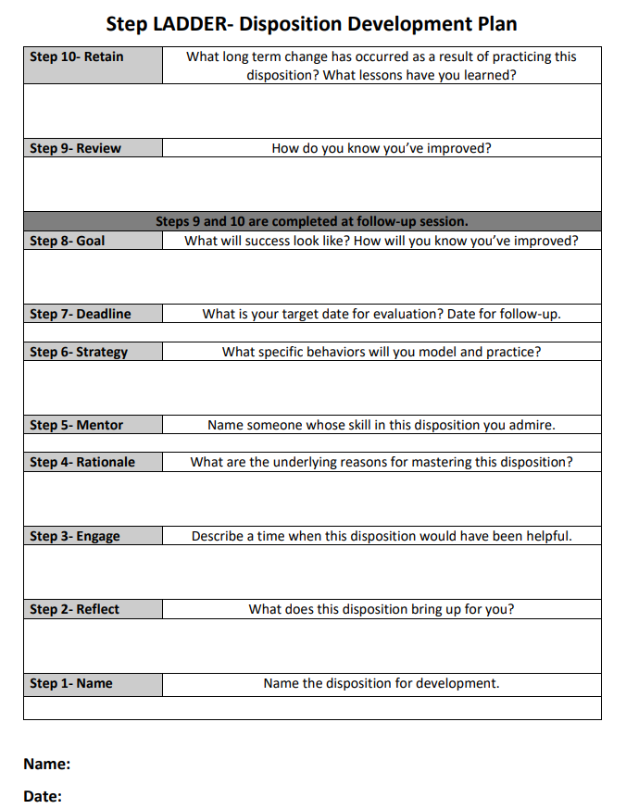
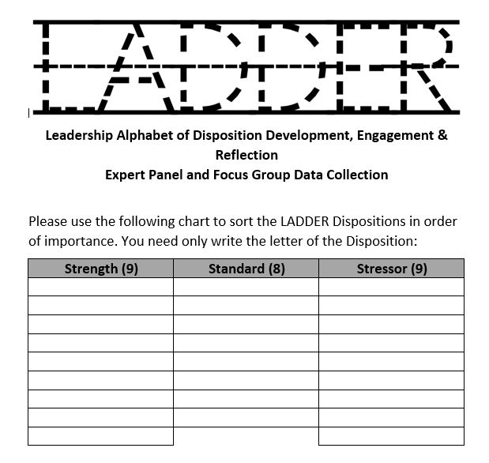
StepLADDER-Development Plan
Step LADDER:
Development plan created from the Principles of Reflective Practice Model (Webb, Driscoll).
Data Collection:
Participants record sort results by letter.

Slide 17
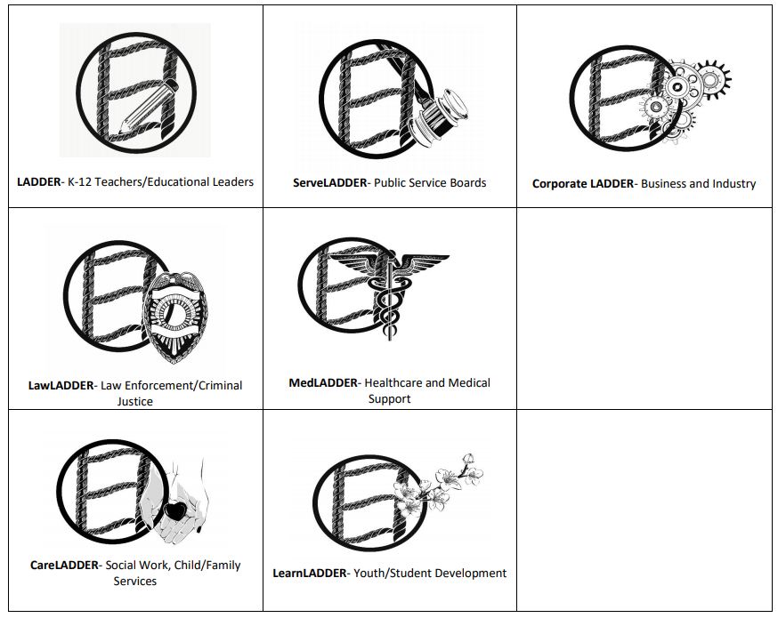
The Future of LADDER
Add
Leslie Blanchard, PhD
Executive Director
Leadership Development Institute
Louisiana State University
173 Coates Hall
Baton Rouge, LA 70803
225-LSU-3806 (O)
LellB@LSU.edu

Slide 18

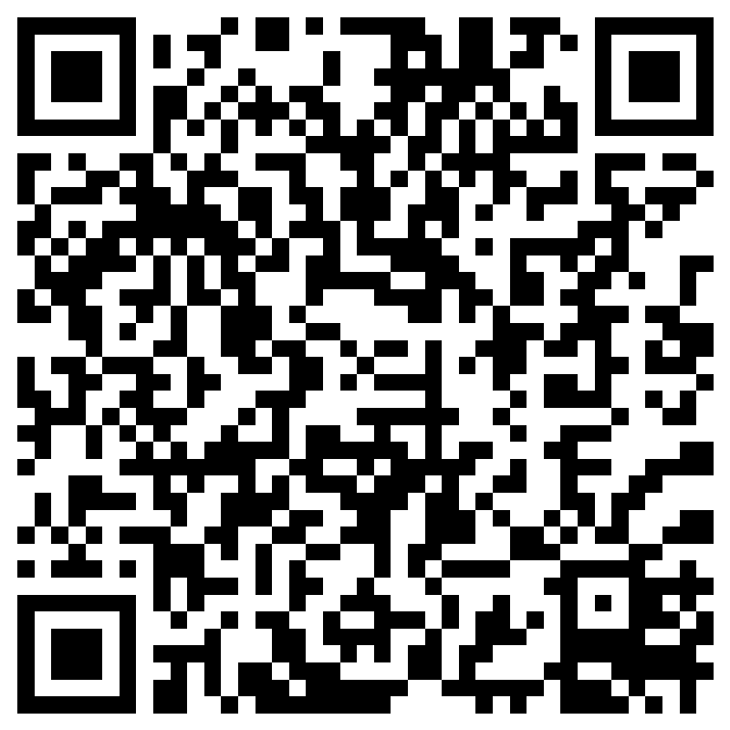
The pilot study
  Aim
  To test if the LADDER approach has beneficial effects on teacher self-efficacy, mental wellbeing and intention to stay in teaching
Notes:
The project was funded by a small Seedcorn funding, hence the small scale and was designed and led by Prof. Beng Huat See from the Durham University Evidence Centre for Education. Our purpose was to test whether the approach is feasible and if there is any promise before we apply for external funding to scale it up. At present along with sharing initial findings we are also looking for schools to take part in our large-scale project. If you are interested in joining the study, the QR code for submitting your details is shared on the slide.

Slide 19
Methodology
Matched comparison design
Intervention group - BA year 3 trainee teachers
They received one face-to-face group coaching
and one online one-to-one coaching
Comparison group – BA year 2 trainee teachers
No intervention, continue business –as – usual
The effects were measured using the difference in the gain scores (between pre- and post-survey) between the control and treatment groups

Slide 20
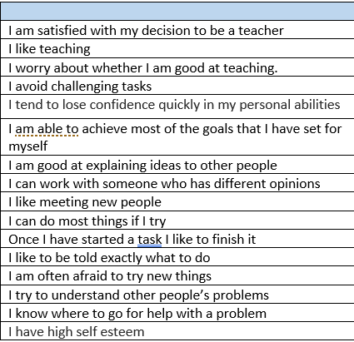
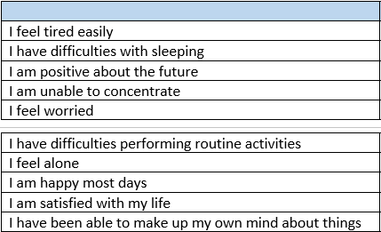

Questionnaire design – pre and post intervention survey
Self-efficacy – 14 items
Wellbeing – 10 items
Intention to stay
Notes:
Pre- coaching survey was conducted in January 2022 before student teachers were introduced to the LADDER training. Post-test was conducted 3 months later in March. Note that the post-survey was conducted after the students have been in schools for their placement training. We felt that this was the best time to test the effect of the LADDER at a time when the students would be exposed to the stress and workload of teaching.
Before we share the results from the Durham pilot, we are delighted to inform that results for the Czech Republic has come in as well and the initial analysis also looks promising, but we have not included the results here because we are waiting for more questionnaires to be returned.

Slide 21
Impact of LADDER on student teachers’ self-efficacy (N =14)
 | Total self-efficacy (pre-intervention) |  | Total self-efficacy (post-intervention) |  | Gain scores |  | Effect size
 | Mean | SD | Mean | SD | Mean | SD
Treatment | 90.00 | 13.540 | 95.14 | 14.253 | 5.14 | 7.712
Comparison | 92.86 | 16.955 | 93.86 | 13.259 | 1.00 | 8.641 | +0.51
Notes:
We estimated the effect of the LADDER approach to coaching by comparing the gain scores of the comparison and the treatment group using Hedges’ g effect size. This is calculated as the difference between the mean gain scores of the 2 groups by the overall (average standard deviation)
Although students who received the LADDER training have shown improvements in their self-efficacy scores and levels of wellbeing, we do not know if similar improvements would have been made if they had not received training. In order to test whether similar gains would be made in the absence of LADDER and thus establish if the intervention has any impact, we need to compare their results with a counterfactual group (the group that did not receive the intervention). For this reason, we compared the results of the intervention group with those of the comparison group. Because the two groups were not balanced at the outset, we used the gain scores instead of the post-test scores only.
Both groups have shown improvements in self-efficacy, but the treatment group has made bigger gains (ES = + 0.51). This suggests that the LADDER approach is promising.

Slide 22
Impact of LADDER on student teachers’ wellbeing (N = 14)
 | Total wellbeing (pre-intervention) |  | Total wellbeing (post-intervention) |  | Gain scores |  | Effect size
 | Mean | SD | Mean | SD | Mean | SD
Treatment | 52.86 | 10.715 | 61.86 | 15.082 | 9.00 | 9.165
Comparison | 62.86 | 14.346 | 58.43 | 13.075 | -4.43 | 6.925 | +1.67
Notes:
This table shows that LADDER has an even stronger impact on student teachers’ wellbeing. While the comparison group has shown a decline in their wellbeing, the treatment has made big gains (ES = +1.67).

Slide 23
Impact on teachers’ intention to stay in teaching
 | Treatment |  | Comparison |  | Mean gain scores |  | Effect size
 | Pre Mean (SD) | Post mean (SD) | Pre Mean (SD) | Post mean (SD) | Treatment | Control
Satisfied to be a teacher | 8.71 (1.254) | 8.57 (1.512) | 8.14 (1.952) | 8.00 (2.082) | -0.14 (0.900) | -0.14 (0.900) | 0
Like teaching | 9.14 (1.069) | 8.86 (1.864) | 9.14 (1.464) | 8.86 (1.574) | -0.29 (1.254) | -0.29 (0.488) | 0
Intention to stay in teaching | 9.00 (1.292) | 9.14 (1.574) | 8.29 (2.289) | 7.86 (2.545) | 0.14 (1.215) | -.043 (1.272) | +0.46
Notes:
We also looked at whether LADDER has any effect on teachers’ intention to stay in teaching. The analysis shows that there is no difference between both groups in terms of their satisfaction with teaching. Both groups appear to be less satisfied with teaching over 3 months. There is also no change and no difference between groups in terms of their passion for teaching. This is not surprising as these students entered teaching because they love to teach.
However, control students were less likely to indicate intention to stay in teaching compared to the treatment group (ES = +0.46). This is a promising sign that the LADDER approach also has the potential to reduce teacher attrition.
We acknowledge that this is only a small pilot study, but the results are reassuring. Funding is applied to scale this up to make LADDER available to more in-service and pre-service teachers.

Slide 24
Narrative comments about the intervention and training
… really appreciated the coaching sessions. The cards given were very useful in preparation for teaching interviews and I feel much more confident in my abilities as a teacher.
I have found the sessions useful in identifying my strengths and weaknesses, however I do feel like the sessions would have been better in Year 2 as I would have found the knowledge of more use in dealing with the workload during the Year 3 placement. Since the first session I have only worked on two of the stressors, but I have improved by prioritising my workload to enable myself to have a better balance to home and work life.
Having struggled with confidence during previous placements, the GlobeLADDER coaching helped me to see my own strengths, as well as identify specific weaknesses.
With the help of the cards, I have been able to recognise areas that I need to focus more on and areas that I am already successful in. This has allowed me to focus more on my teaching in the classroom due to the removal of some of the stresses that would have previously existed without the cards.
Notes:
Finally we would like you to take some time to read some of the personal testimonies from our treatment group students.

Slide 25
Lessons learnt so far…
Consider introducing LADDER coaching in BA Year 2
Group coaching
Peer sharing
Introduce as a part of interview / job preparation
Scale up the project / looking for new partners

Slide 26
Want to be a part of GlobeLADDER project
Please contact on any of the following emails:
  Leslie Blachard - lellb@lsu.edu
  Beng Huat See - b.h.see@durham.ac.uk
  Kulwinder Maude - kulwinder.maude@durham.ac.uk
                Or
  Scan the QR code now to enter your details.

Slide 27
References
Annemaree Carroll, Libby Flynn, Emma Sanders O’Connor, Kylee Forrest, Julie Bower, Samuel Fynes-Clinton, Ashley York & Maryam Ziaei (2021) In their words: listening to teachers’ perceptions about stress in the workplace and how to address it, Asia-Pacific Journal of Teacher Education, 49:4, 420-434, DOI: 10.1080/1359866X.2020.1789914
Department for education. (2018). Mental health and behaviour in schools.
Hanušová, S. et al (2017). Chtějí zůstat nebo odejít? Začínající učitelé v českých základních školách. Masarykova univerzita. English = Do they want to stay or leave? Beginning teachers in Czech primary schools. Available at: https://munispace.muni.cz/library/catalog/book/1015
OECD (2018) TALIS teacher questionnaire. https://www.oecd.org/education/school/TALIS-2018-MS-Teacher-Questionnaire-ENG.pdf
OECD (2018). Teaching and Learning International Survey (TALIS). https://www.oecd.org/education/talis/talis-2018-data.htm
OECD (2021). Building teachers’ wellbeing from primary to upper secondary education. Paris: OECD. https://www.oecd-ilibrary.org/docserver/722fe5cb
Office for Standards in Education [Ofsted]. (2019a) Education inspection framework.
Teacher Labour Market in England: Annual Report 2021. Available at: https://files.eric.ed.gov/fulltext/ED615303.pdf
Tray Geiger & Margarita Pivovarova (2018) The effects of working conditions on teacher retention, Teachers and Teaching, 24:6, 604-625, DOI: 10.1080/13540602.2018.1457524
Yu, X., Wang, P., Zhai, X. et al. The Effect of Work Stress on Job Burnout Among Teachers: The Mediating Role of Self-efficacy. Soc Indic Res 122, 701–708 (2015). https://doi.org/10.1007/s11205-014-0716-5

Slide 28
*Extended references available upon request
References
References:
Lombardo, M. M., & Eichinger, R. W. (2000). High potentials as high learners. Human Resource Management, 39(4), 321–329.
Oliver, D. H., Church, A. H., Lewis, R., & Desrosiers, E. I. (2009). An integrated framework for assessing, coaching and developing global leaders. In W. H. Mobley, Y. Wang & M. Li (Eds.), Advances in global leadership (Vol. 5; pp.195–224). Bingley, UK: Emerald Group.
Park, S., Jeong, S., Jang, S., Yoon, S. W., & Lim, D. H. (2018). Critical review of global leadership literature: Toward an integrative global leadership framework. Human Resource Development Review, 17(1), 95–120.
Prastacos, G. P., Soderquist, K. E., & Vakola, M. (2005). A strategic forward-looking approach to competency modelling. Business Leadership Review II:II, 1–5.
Seemiller, C. (2018). A competency-based model for youth leadership development. Journal of Leadership Education, 17(1), 56–72.Tables Table 1: The Leadership Architect ® 2009 global norms by job function (Dai, Tan
Day, D. V. (2018). The Leadership Quarterly yearly review: Pushing the frontiers of leadership scholarship. The Leadership Quarterly, 1.
Dai, G., Tang, K. Y., De Meuse, K. P. (2009). The Leadership Architect ® 2009 global norms Report 1: Competency norms and analysis. Korn Ferry International: Minneapolis, MN.
De Meuse, K. P., Dai, G., Swisher, V. V., Eichinger, R. W., & Lombardo, M. M. (2012). Leadership development: Exploring, clarifying, and expanding our understanding of learning agility. Industrial and Organizational Psychology, 5, 280–315.
Notes:
Scientific or Scholarly Significance
1) An evidence based validated instrument for disposition screening and development
2) A replicable model for teacher preparation programs to develop dispositions in aspiring educators
3) A diagnostic and prescriptive tool for in-service educators to identify stressors through self reflection
4) Framework for current and perspective administrators to develop relevant leadership dispositions
Use refs from: Lacy’s paper, Horace Mann, Dr. Madden paper

Slide 29
Want to be a part of GlobeLADDER project
Please contact on any of the following emails:
  Leslie Blachard - lellb@lsu.edu
  Beng Huat See - b.h.see@durham.ac.uk
  Kulwinder Maude - kulwinder.maude@durham.ac.uk
                Or
  Scan the QR code now to enter your details.
Notes:
Scientific or Scholarly Significance
1) An evidence based validated instrument for disposition screening and development
2) A replicable model for teacher preparation programs to develop dispositions in aspiring educators
3) A diagnostic and prescriptive tool for in-service educators to identify stressors through self reflection
4) Framework for current and perspective administrators to develop relevant leadership dispositions
Use refs from: Lacy’s paper, Horace Mann, Dr. Madden paper

